Slide 1



Estimating Temporal Validity of Text
Adam Jatowt
Mots/Machines #6
8 March 2024
Few months unless
kept updated..

Slide 2
Add novel results from arxiv of Georg
Abstract:
It is important to learn whether information is still valid or not for various downstream applications including recommender systems, information retrieval, and user state tracking on microblogs and via chatbot conversations. It is also beneficial to deeply understand the story by tracking implicit information about the durations of protagonists' activities and involved events. However, this kind of inference is still difficult for machines as it usually requires temporal commonsense knowledge and reasoning.
We propose and investigate a series of novel tasks related to temporal commonsense reasoning such as temporal validity estimation, temporal validity reassessment, and temporal validity change prediction of an input text given some follow-up context.
In essence, these tasks require inference whether actions expressed in text are still ongoing or have been completed, hence whether the describing them content remains valid, or has rather become obsolete, either due to the elapsed time or based on the provision of additional context.
Additionally, we also discuss several novel datasets that we have constructed for probing LLMs and NLP models in general when it comes to temporal validity estimation and reasoning.
Think about difference of TV tasks and ones on MCTaco:

Slide 3
Today’s Agenda
Introduction & Background
Temporal Commonsense Reasoning of LLMs
Novel tasks
Temporal text validity
Temporal text validity reassessment
Temporal validity change prediction
Injecting time into LLMs
Conclusions

Slide 4
Time & Text
Time is of the essence:
A key aspect of stories, events, narrative documents, message streams, etc.
Can determine if documents are relevant
Can tell how the different story pieces should be combined
Can help in correct text understanding & and information extraction…
…
So far, the NLP and IR communities placed rather limited focus on research towards understanding and utilizing temporal aspects of text…

Slide 5
Two Main Types of Temporal Knowledge
Temporal Commonsense Knowledge
E.g., visiting a doctor is after breaking the leg rather than before
E.g., going on holiday takes longer than going for a walk
Temporal Factual Knowledge
E.g., Barack Obama was the US president from 2009 to 2017
E.g., Hiroshima and Nagasaki bombings were after the Attack on Pearl Harbor
Notes:
570k human-written English sentence pairs manually labeled for balanced classification with the labels entailment, contradiction, and neutral.

Slide 6
Temporal Commonsense Reasoning
Raghav Jain, Daivik Sojitra, Arkadeep Acharya, Sriparna Saha, Adam Jatowt, Sandipan Dandapat: Do Language Models Have a Common Sense regarding Time? Revisiting Temporal Commonsense Reasoning in the Era of Large Language Models, Proc. of EMNLP 2023

Slide 7
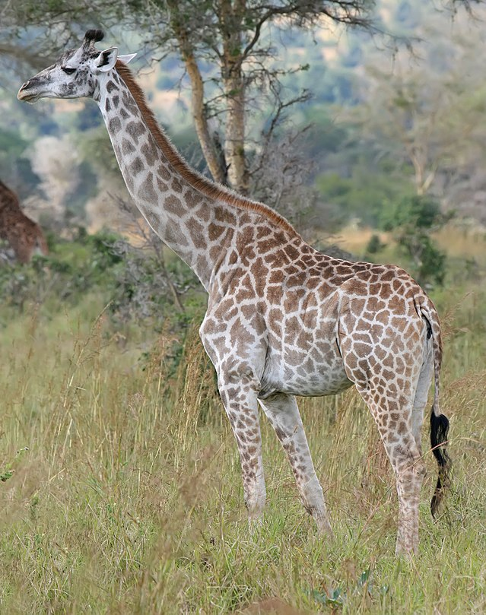
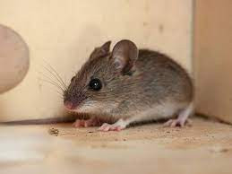
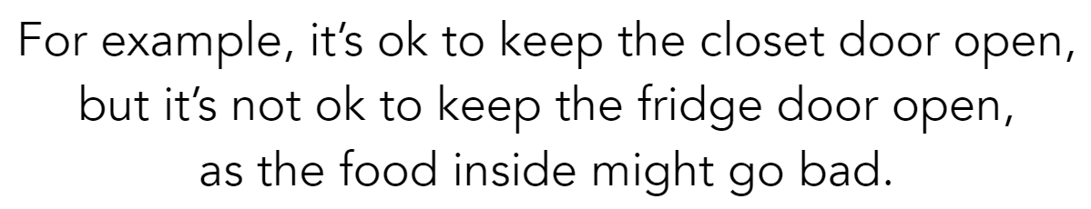
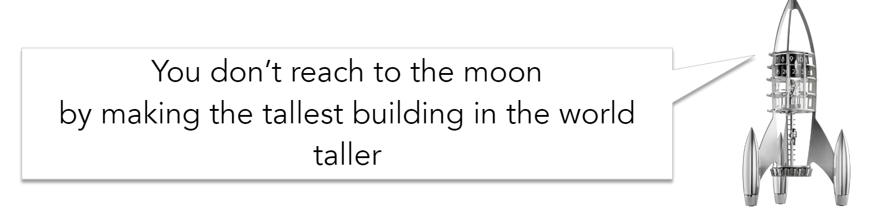
Commonsense Reasoning
the basic level of practical knowledge and reasoning
concerning common situations and events
that are commonly shared among most people
<
Y. Choi et al., ACL 2020 Commonsense Tutorial, https://maartensap.com/acl2020-commonsense/
Notes:
https://maartensap.com/acl2020-commonsense/slides/01%20-%20Intro.pdf

Slide 8
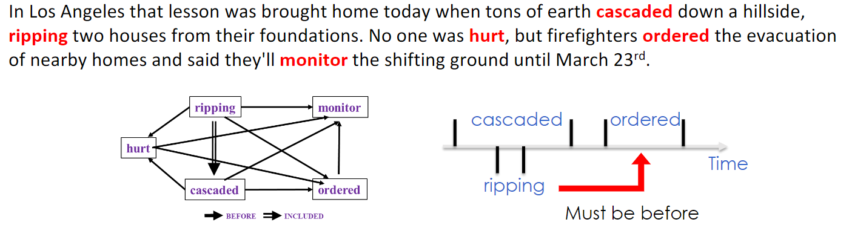
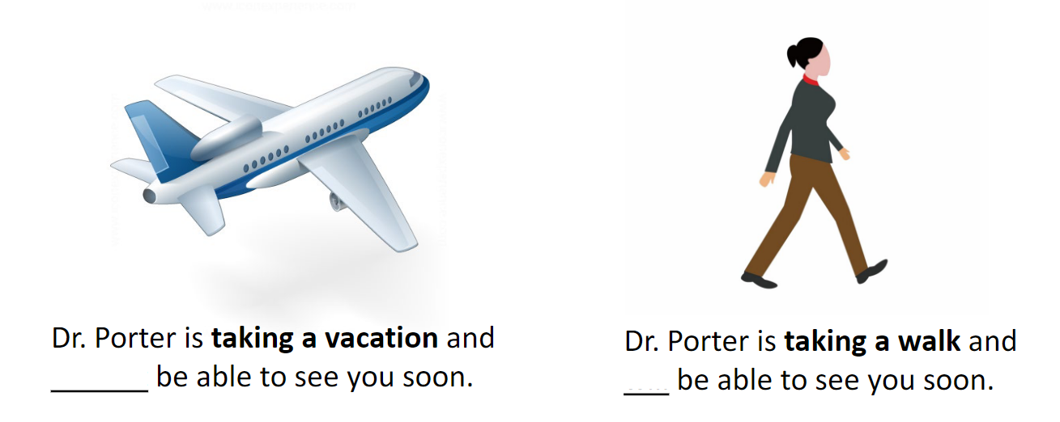
Temporal Commonsense Reasoning Examples
https://maartensap.com/acl2020-commonsense
https://maartensap.com/acl2020-commonsense
Y. Choi et al., ACL 2020 Commonsense Tutorial, https://maartensap.com/acl2020-commonsense/
G. Wenzel, A. Jatowt: “An Overview of Temporal Commonsense Reasoning and Acquisition”, 2023, arxiv

Slide 9
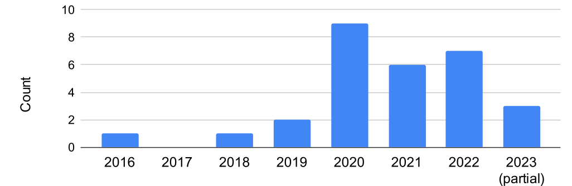
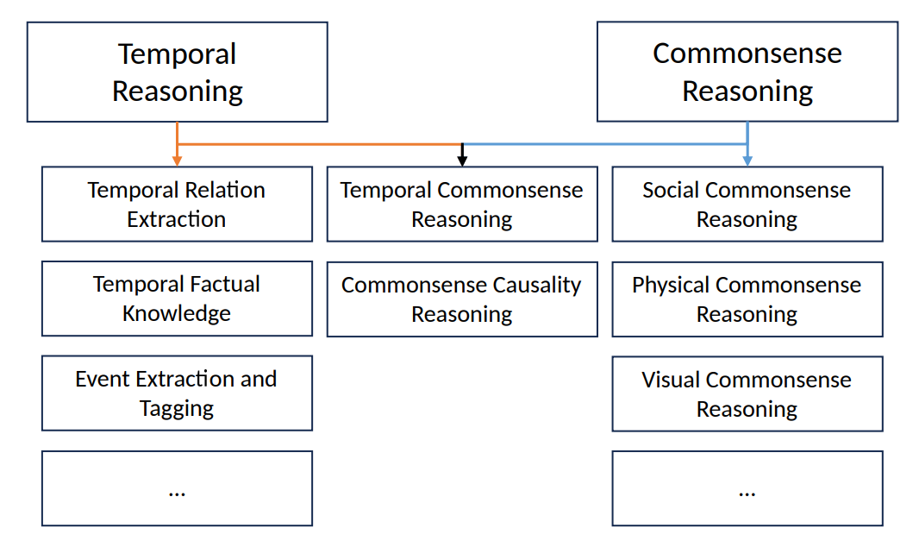
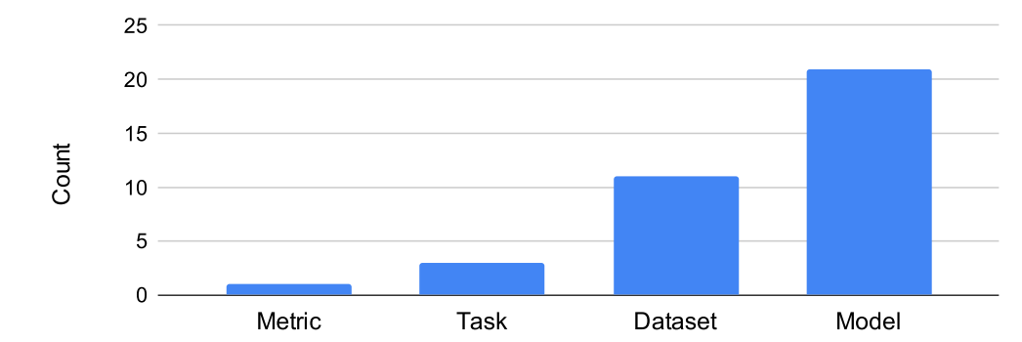
Temporal Commonsense Reasoning Research Area
G. Wenzel, A. Jatowt: “An Overview of Temporal Commonsense Reasoning and Acquisition”, 2023, arxiv

Slide 10
Temporal Commonsense Reasoning
A language model with a robust understanding of temporal context is primed to perform better on downstream NLP tasks such as:
storytelling (Mostafazadeh et al., 2016)
natural language inference (Hosokawa et al., 2023)
timeline understanding (Steen and Markert, 2019)
user status tracking (Xia and Qi, 2022)
dialogue management
etc.

Slide 11
Types of Commonsense Reasoning
Different types of temporal commonsense reasoning tasks (Zhou et al, 2019):
Event Duration (ED):
reasoning about event durations.
Event Ordering (EO):
reasoning about the typical sequence of events.
Frequency (F):
reasoning about the frequency of event occurrences.
Stationarity (S):
reasoning about the length of state persistence.
Typical Time (TT):
reasoning about the specific timing of events.
Ben Zhou, Daniel Khashabi, Qiang Ning, and Dan Roth. “Going on a vacation” takes longer than “going for a walk”: A study of temporal commonsense understanding. EMNLP-IJCNLP 2019

Slide 12
Temporal Text Validity

Slide 13
Temporal Validity Estimation: News Example
Assume you read the following sentences in a newspaper published 1 month ago:
“Chancellor of Austria is visiting France."
“France is a member of United Nations.”
Which would you consider still as true?

Slide 14
Tweet Example
Assume you have just received the following message from your friend:
“I am taking a walk."
How long would you consider it as still being true?
msg C
t
Is C still
valid?

Slide 15
Temporal Validity Definition
Temporal validity is a measure of how long the information remains valid after it has been created or expressed
Given a content C created at time t, its validity period is the maximum time after t during which the information expressed in C remains valid

Slide 16


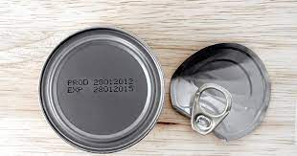
Temporal Validity of Text as Information Expiry Date
Analogy to Product’s Expiry Date:
Important concept determining the time until which a product, or more generally an object, remains usable
Axel Almquist, Adam Jatowt: Towards Content Expiry Date Determination: Predicting Validity Periods of Sentences. ECIR 2019, pp. 86-101

Slide 17
Example Temporal Validity Applications
Measuring text obsoleteness
Recommender systems
Enhancing information retrieval (e.g., filtering Twitter timeline)
Conversational AI
Fact checking
Story understanding
Etc.

Slide 18
Validity Classes
Within a few hours | “So Michi, Audrey, Joel and myself are all hanging out in Linda’s basement.”
Within a few days | “School starts at a later time on Wednesday but that’s no big deal.”
Within a few weeks | “I am taking a course on learning how to use the program 3d studio max.”
Within a few months | “I am also playing a gig with the new millennium string orchestra at the beginning of next month.”
Within a few years or more | “The middle eastern nation of Israel is planning to expand its settlements, its housing areas in the west bank.”
Validity Classes
Axel Almquist, Adam Jatowt: Towards Content Expiry Date Determination: Predicting Validity Periods of Sentences. ECIR 2019, pp. 86-101

Slide 19
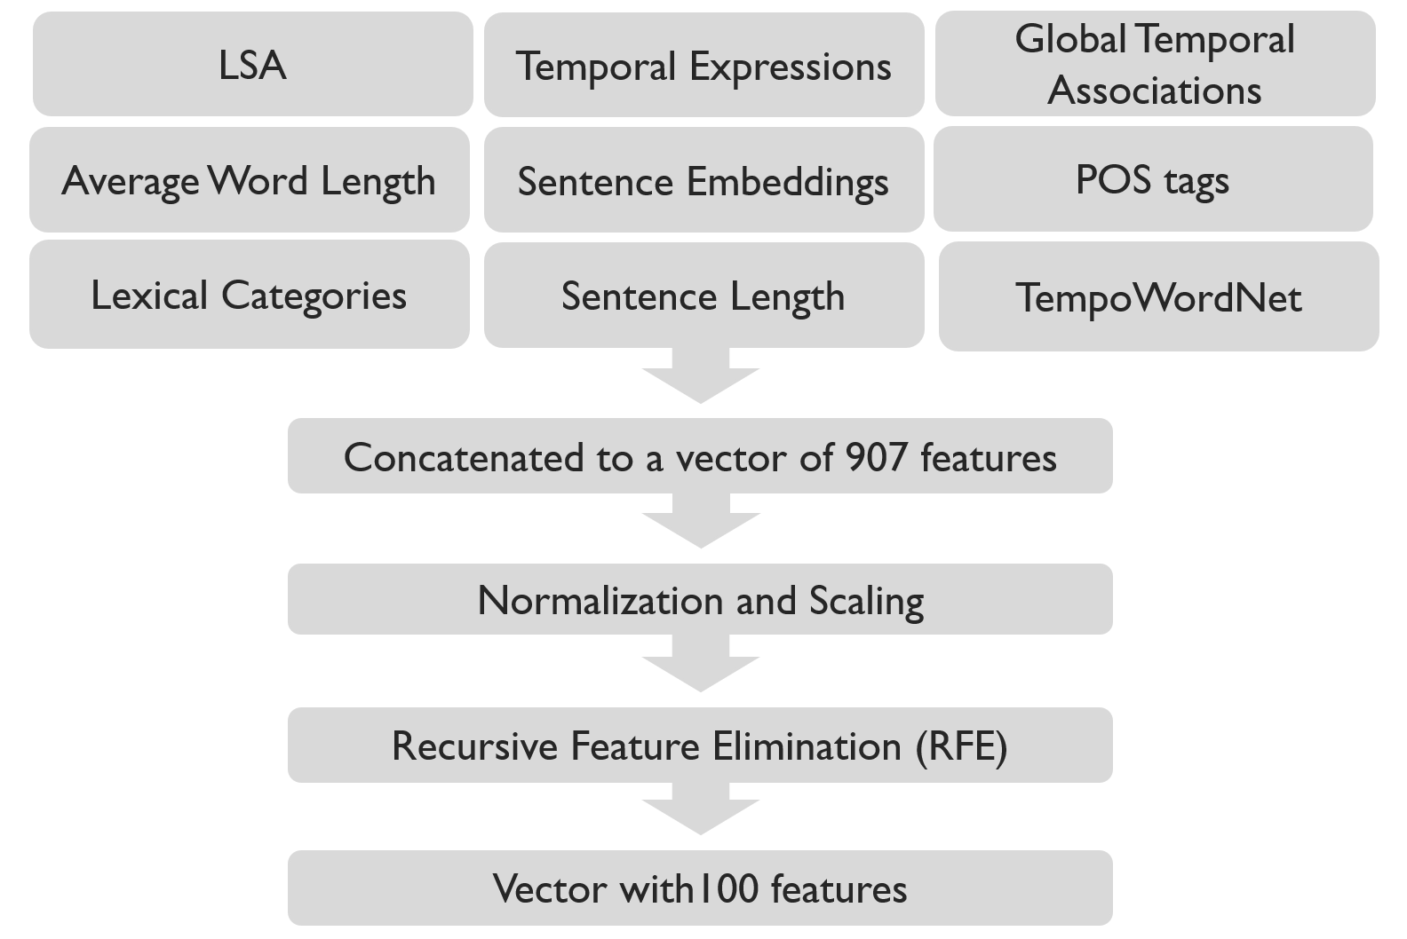
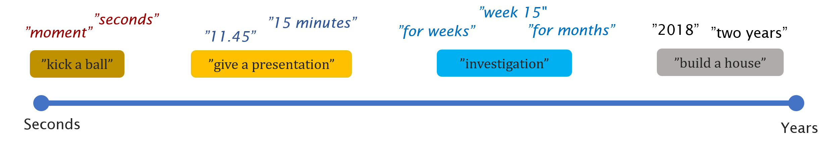
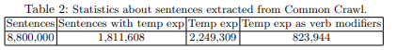
Simple Approach for Estimating Temporal Validity
Features
Computed by measuring co-occurrences of duration temporal expressions and words in Common Crawl
Axel Almquist, Adam Jatowt: Towards Content Expiry Date Determination: Predicting Validity Periods of Sentences. ECIR 2019, pp. 86-101
Notes:
GTA is calculated by counting co-occurrences of temporal expressions and words in a large corpus; we used Common Crawl, processing close to 9 million sentences
We take the PMI (Pointwise Mutal Information) of a word or a combination of words with different temporal granularities (PMI vectors for all the six possible words and combinations related to the target sentence’s root verb: S, V, O, SV, VO, SVO)
PMI( ”build”,”house”, DURATION_DAY) gives the association strength between the term combination (‘build’,‘house’) and the duration of day granularity

Slide 20
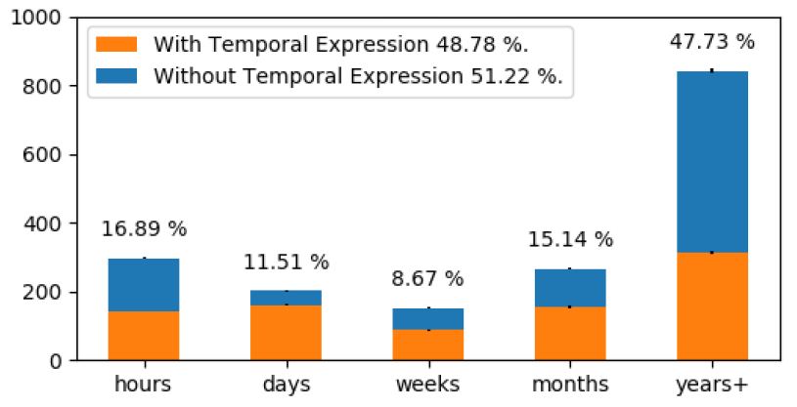
Temporal Validity Estimation Datasets
Estimate how long an action expressed in a sentence would typically take place
Task: classification
Classes:
hours, days, weeks, months, years (or longer)
Size:
1.7k
Source:
blogs, news, Wikipedia
Generation way: crowdsourcing
Almquist and Jatowt: Towards Content Expiry Date Determination: Predicting Validity Periods of Sentences. ECIR 2019
Lynden et al.: Commonsense Temporal Action Knowledge (CoTAK) Dataset, CIKM 2023

Slide 21
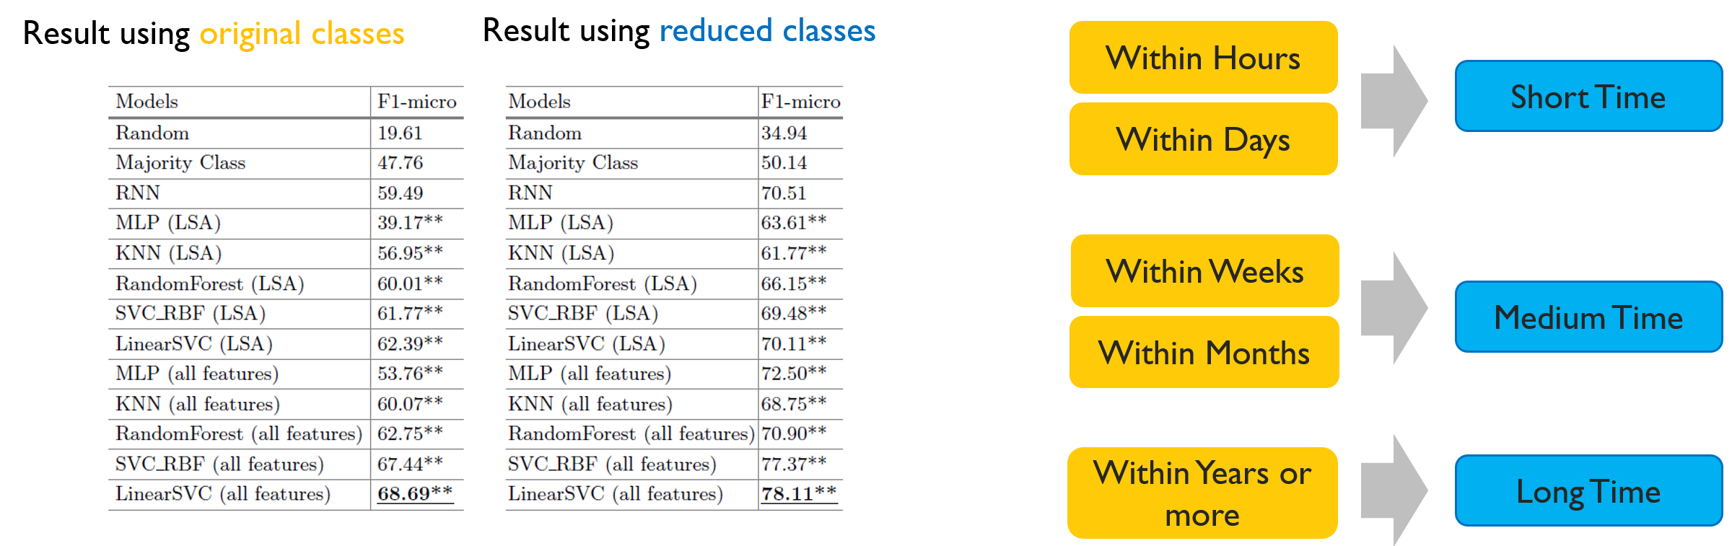
Experimental Results

Slide 22
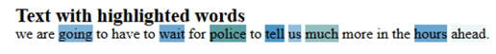
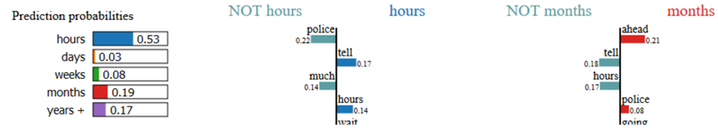
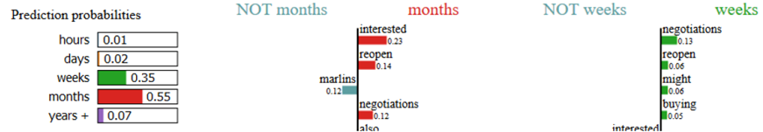
Examples of Classified Sentences
LIME: https://github.com/marcotcr/lime

Slide 23
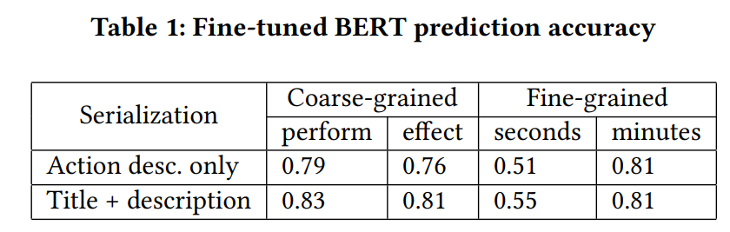
Temporal Validity Estimation Datasets
Estimate how long an action expressed in a sentence would typically take place
Task: classification
Classes:
hours, days, weeks, months, years (or longer)
seconds, minutes, hours, days, longer
Size:
1.7k
>300k
Source:
blogs, news, Wikipedia
WikiHow sentences
Generation way: crowdsourcing
Examples: “lift the foot”, “remove the old shoe”, “clean the hoof”, etc.
Almquist and Jatowt: Towards Content Expiry Date Determination: Predicting Validity Periods of Sentences. ECIR 2019
Lynden et al.: Commonsense Temporal Action Knowledge (CoTAK) Dataset, CIKM 2023

Slide 24


Current Work: Multimodal task extension
Building a dataset
<
Expected time needed to do an action: “tidy the room”

Slide 25
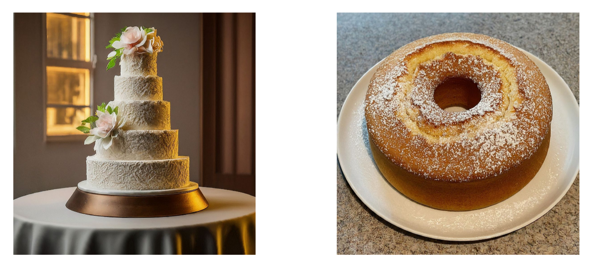
Current Work: Multimodal task extension
Building a dataset
>
Expected time needed to do an action: “cook a cake”

Slide 26
Current Work: Obsoleteness Prediction in Text
Input text
Brest is a port city in the Finistère department, Brittany. Located in a sheltered bay not far from the western tip of a peninsula and the western extremity of metropolitan France, Brest is an important harbour and the second largest French military port after Toulon. The city is located on the western edge of continental France. With 139,456 inhabitants, Brest forms Western Brittany's largest metropolitan area (with a population of 370,000 in total), ranking third behind only Nantes and Rennes in the whole of historic Brittany, and the 25th most populous city in France (2019); moreover, Brest provides services to the one million inhabitants of Western Brittany.
François Cuillandre is the mayor of the city..

Slide 27
Current Work: Obsoleteness Prediction in Text
Input text
Brest is a port city in the Finistère department, Brittany. Located in a sheltered bay not far from the western tip of a peninsula and the western extremity of metropolitan France, Brest is an important harbour and the second largest French military port after Toulon. The city is located on the western edge of continental France. With 139,456 inhabitants, Brest forms Western Brittany's largest metropolitan area (with a population of 370,000 in total), ranking third behind only Nantes and Rennes in the whole of historic Brittany, and the 25th most populous city in France (2019); moreover, Brest provides services to the one million inhabitants of Western Brittany.
François Cuillandre is the mayor of the city..

Slide 28
Temporal Text Validity Reassessment

Slide 29
Temporal Text Validity Reassessment
Assume you have just received the following message from your friend:
Post A: "I am taking a walk “
Post B: “Getting a cup of coffee for take-away”
Post C: “Just started preparing dinner”
Is the post A still true after reading post B?
How about after reading post C?
msg A
msg B
Is A still
valid?
Taishi Hosokawa, Adam Jatowt, Kazunari Sugiyama: Temporal Natural Language Inference: Evidence-based Evaluation of Temporal Text Validity, ECIR 2023

Slide 30
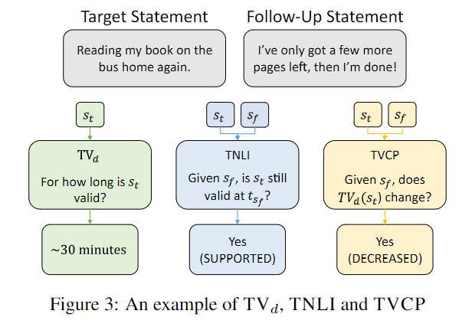
Context-based Temporal Validity Prediction: Temporal Text Validity Reassessment
Estimate if an action expressed in a sentence would continue or cease to take place in view of additional context
Task: classification
Classes: supported, invalidated, neutral
Taishi Hosokawa, Adam Jatowt, Kazunari Sugiyama: Temporal Natural Language Inference: Evidence-based Evaluation of Temporal Text Validity, ECIR 2023

Slide 31
Example Application Scenario
Target tweet
Classifier
Does any of the follow-up tweet render the original tweet obsolete?
Follow-up tweet
(select one)

Slide 32
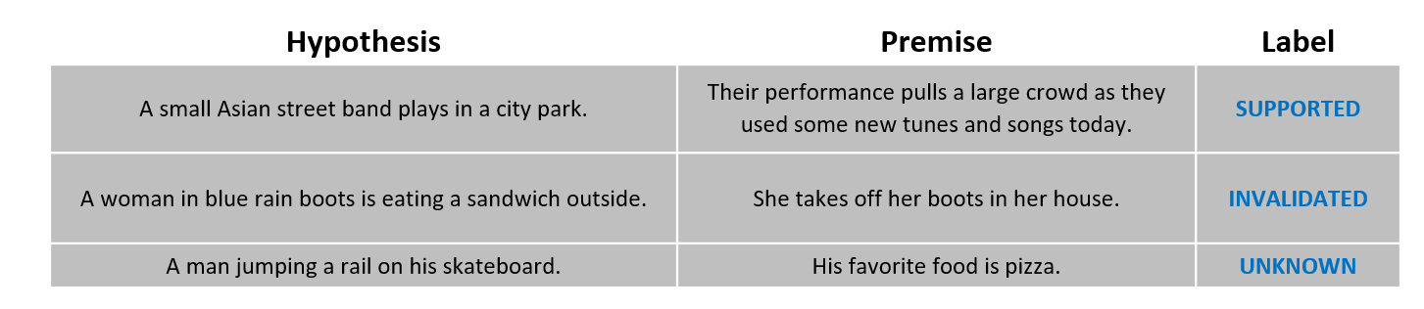
Similarity to Natural Language Inference (aka. Text Entailment)
Natural Language Inference (NLI): task of determining the inference relation between two short texts
3 classes: Entailment, Contradiction and Neutral
Premise
Hypothesis
Label
A soccer game with multiple males playing. | Some men are playing a sport. | Entailment
A black race car starts up in front of a crowd of people. | A man is driving down a lonely road. | Contradiction
A smiling costumed woman is holding an umbrella. | A happy woman in a fairy costume holds an umbrella. | Neutral
https://nlp.stanford.edu/projects/snli/

Slide 33
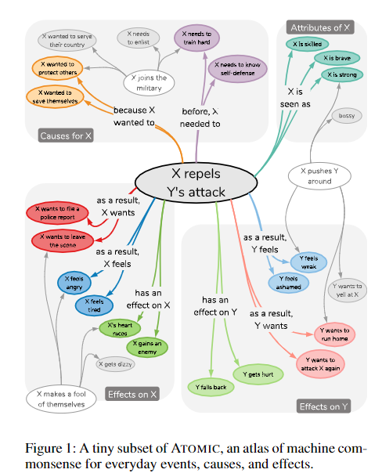
ATOMIC Knowledge Base
Commonsense Reasoning Knowledge Base (1.33M commonsense knowledge tuples and 23 relations)
Includes ConceptNet knowledge
ConceptNet - the most commonly used commonsense
knowledge base about physical entities
9 if-then relation classes
cause
reaction
intention
effect
…
Many physical and event-centered relations
“IsAfter”, “IsBefore”, “HasSubEvent”, “HinderedBy”
https://homes.cs.washington.edu/~msap/atomic/
Notes:
There are different KGs such as FrameNet, WikiHow, Howto100m, or VerbNet that could be utilized for our task, but we think that ATOMIC-2020 is the most appropriate to achieve our goal due to its temporal common-sense knowledge contained as well as usability in terms of its format.
It is the atlas of everyday commonsense reasoning, organized through 877k textual descriptions of inferential knowledge

Slide 34
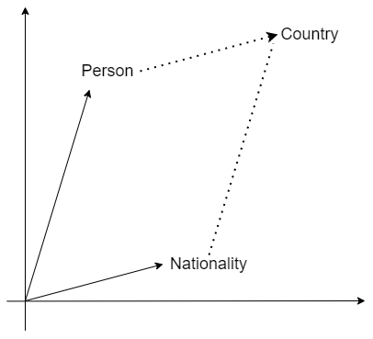
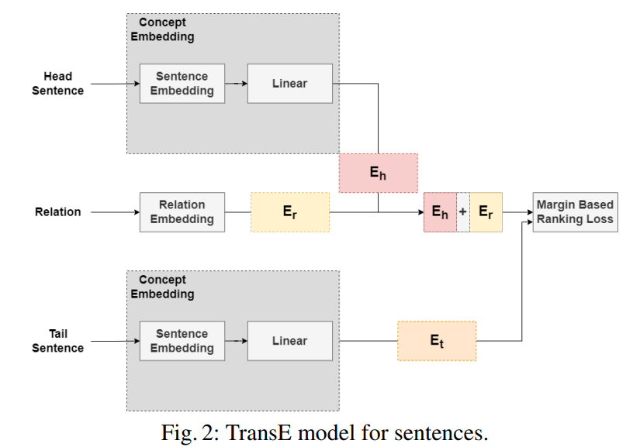
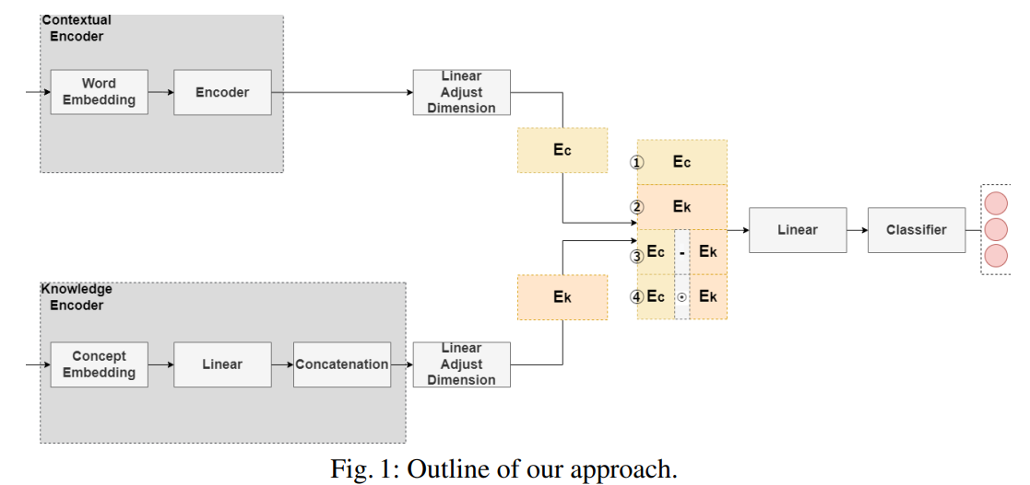
Proposed Model
Embedding in knowledge bases (TransE):
head entity + relation = tail entity
Learns information from a knowledge base
- Uses embeddings for representing data in knowledge base
- Knowledge base: tuples <head entity, relation, tail entity>
Combines text-based method (e.g., BERT) with knowledge-based encoding method (e.g., TransE)
Bordes, A., Usunier, N., Garcia-Duran, A., Weston, J., & Yakhnenko, O. (2013). Translating embeddings for modeling multi-relational data. Advances in neural information processing systems, 26.

Slide 35
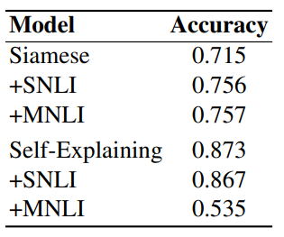
Initial Analysis using NLI-based Pretraining
NLI-based pretraining improves Siamese network’s performance
NLI-based pretraining does not improve the result of Self-Explaining model (SOTA model for NLI)
NLI-related information may be already included during the pre-training for Self-Explaining model
SUPPORTED = Entailment (NLI)
INVALIDATED = Contradiction (NLI)
UNKNOWN = Neutral (NLI)
Sun, Zijun, et al. "Self-explaining structures improve nlp models." arXiv preprint arXiv:2012.01786 (2020).
Notes:
Span based attention on Roberta model (pretraining is different on more data due to Roberta) and many parameters are tuned and loss functions and tasks
The key point of the proposed framework is to put an additional layer, as is called by the interpretation layer, on top of any existing NLP model. This layer aggregates the information for each text span, which is then associated with a specific weight, and their weighted combination is fed to the softmax function for the final prediction. The proposed model comes with the following merits: (1) span weights make the model self-explainable and do not require an additional probing model for interpretation; (2) the proposed model is general and can be adapted to any existing deep learning structures in NLP; (3) the weight associated with each text span provides direct importance scores for higher level text units such as phrases and sentences.
Generally, pre-training with NLI datasets improves accuracy in many downstream tasks

Slide 36
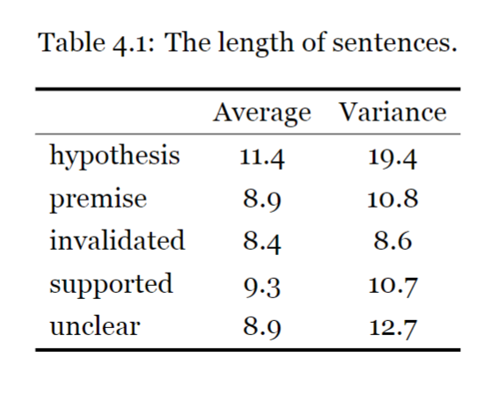
Constructing Dataset
Hypotheses: randomly sampled 5k premises from SNLI
Premises: created through crowdsourcing with AMT for each of 3 classes and subject to manual verification
Result: 10,659 sentence pairs balanced over 3 classes
Notes:
5fold cross va
Since it has been pointed out that the number of words in each sentence varies greatly depending on the label in some datasets of NLI [Khot et al., 2018], we examined the average number of words in each sentence validation

Slide 37
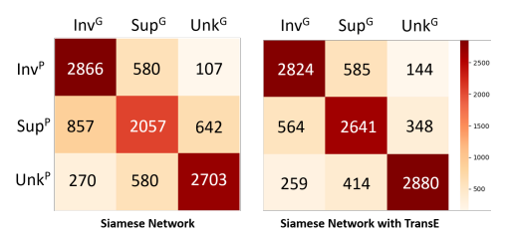
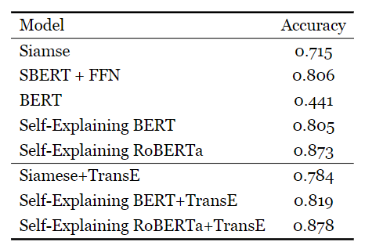
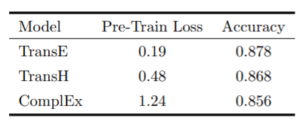
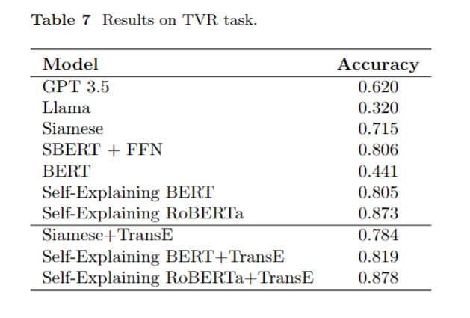
Experimental Results
Ground truth
Self-explaining model performs best
Siamese + TransE performs better than Siamese
Self-explaining + TransE has almost same accuracy as self-explaining
Predicted
Siamese
Tested variants of TransE
(in conjunction with Self-Explaining model)
Siamese + TransE
Incorporating TransE to Siamese net helps to more correctly determine SUPPORTED and UNKNOWN classes (improvement of 28% and 6.5%), while only slightly confusing the INVALIDATED class (decrease of 1.4%)

Slide 39
Temporal Text Validity Change Prediction

Slide 40
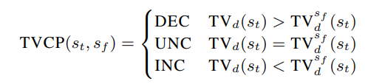
Temporal Validity Change Prediction
Estimate if an action expressed in a sentence would increase or decrease the temporal validity of another sentence
Task: classification
Classes: decreased, increased, neutral
Georg Wenzel, Adam Jatowt: Temporal Validity Change Prediction. CoRR abs/2401.00779 (2024) https://arxiv.org/pdf/2401.00779.pdf

Slide 41
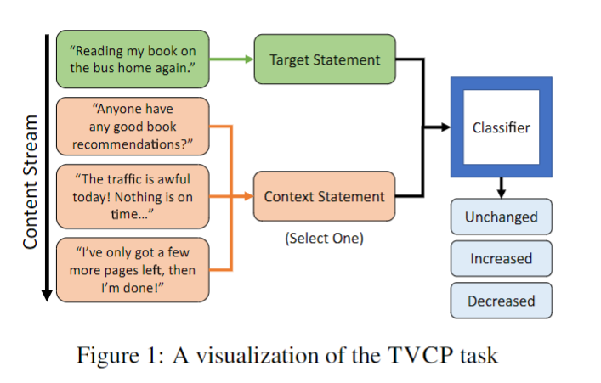
Application Scenario
Target tweet
Does any of the follow-up tweet changes the temporal validity duration of the original tweet?
Classifier
Follow-up tweet
(select one)
“I have a doctors appt in 10 minutes which means I might have to wait for an hour”
“Tick tock. This is always so boring, no one ever tells me how long I am going to be here.”
No change in expected validity.
“The doctor was actually on time for once, so glad the visit is going quickly”
Decreased expected validity
“The doctor got called away on an emergency. Will have to reschedule later this week.”
Increased expected validity

Slide 42
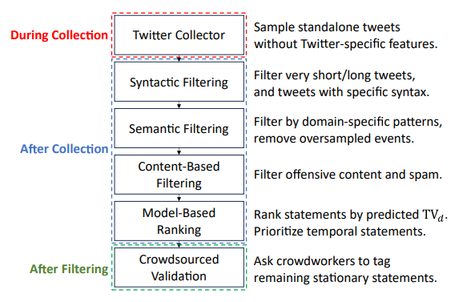
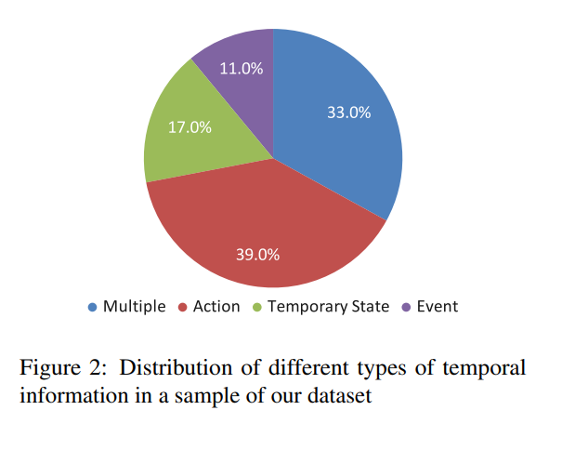
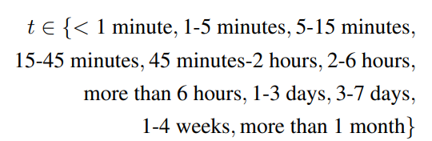
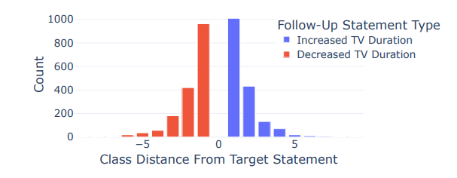
Dataset building
Size: 5k
Source: sentences from Twitter
Generation way: crowdsourcing

Slide 43
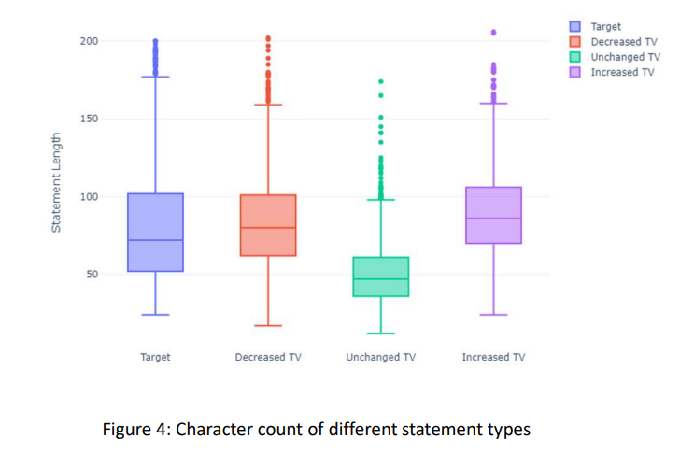

Slide 44
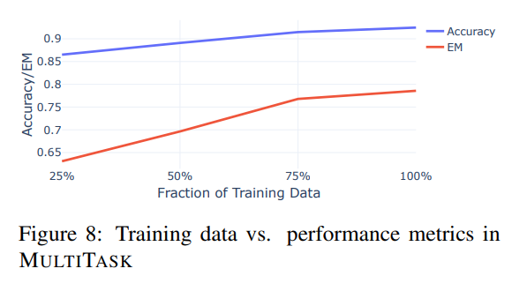
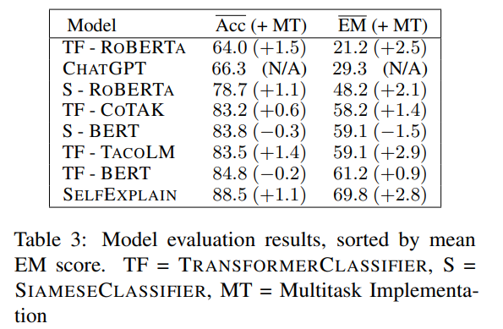
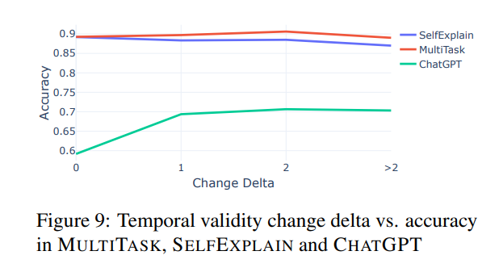
Results

Slide 45
Temporal Validity Change Prediction
Estimate if an action expressed in a sentence would increase or decrease the temporal validity of another sentence
Task: classification
Classes: decreased, increased, neutral
Size: 5k
Source: sentences from Twitter
Generation way: crowdsourcing

Slide 46
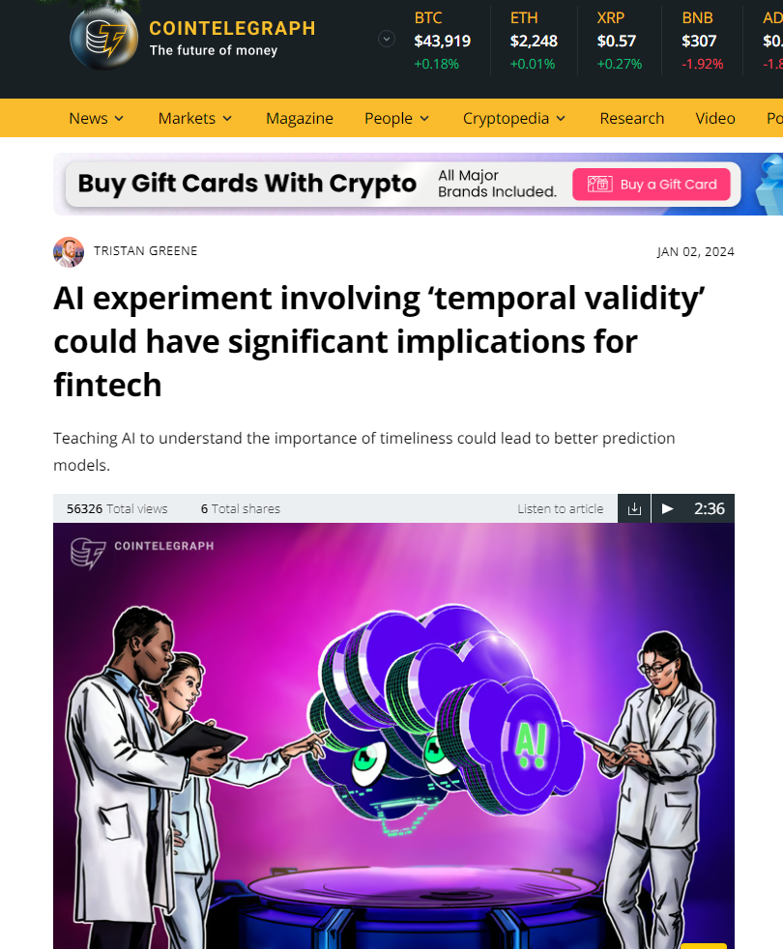
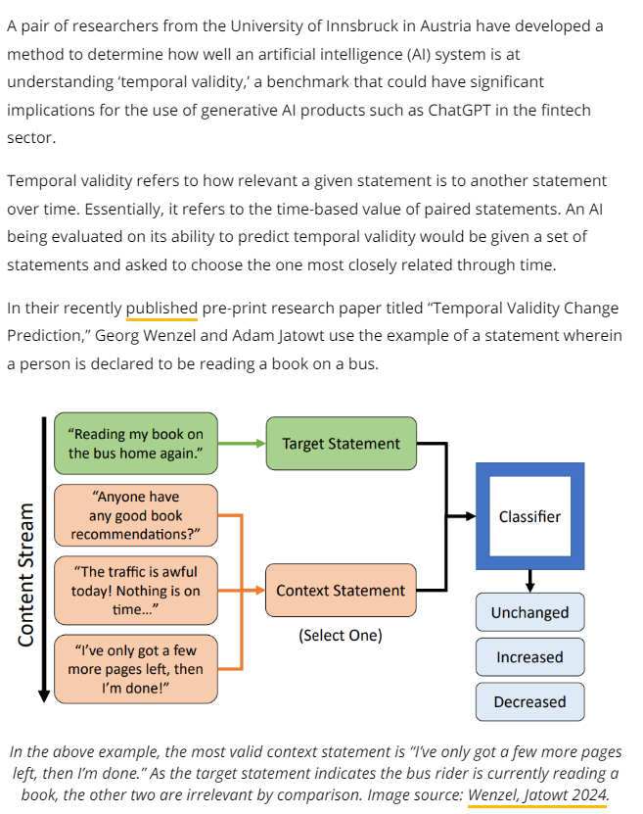
https://cointelegraph.com/news/ai-artificial-intelligence-experiment-involving-temporal-validity-significant-implications-fintech

Slide 47
Incorporating Time into LLMs

Slide 48
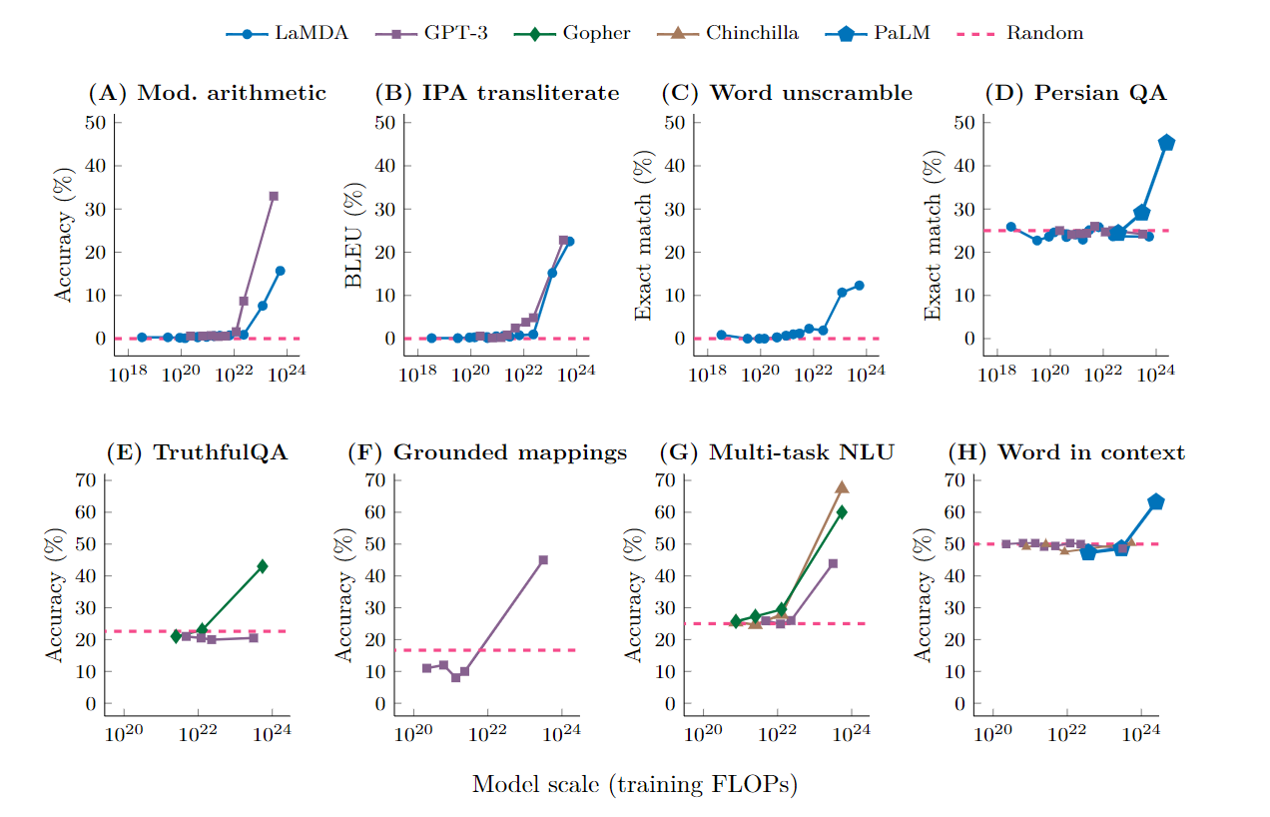
Effect of Scale: Emergent Abilities of Large Language Models
Abilities that cannot be predicted by extrapolating performance improvements
Models gain suddenly good performance on some tasks once the scale exceeds a certain range
One explanation is that complex tasks with multiple steps cannot be handled by models unless they are large enough to handle every step.
Wei, Jason, et al. "Emergent abilities of large language models." arXiv preprint arXiv:2206.07682 (2022).

Slide 49
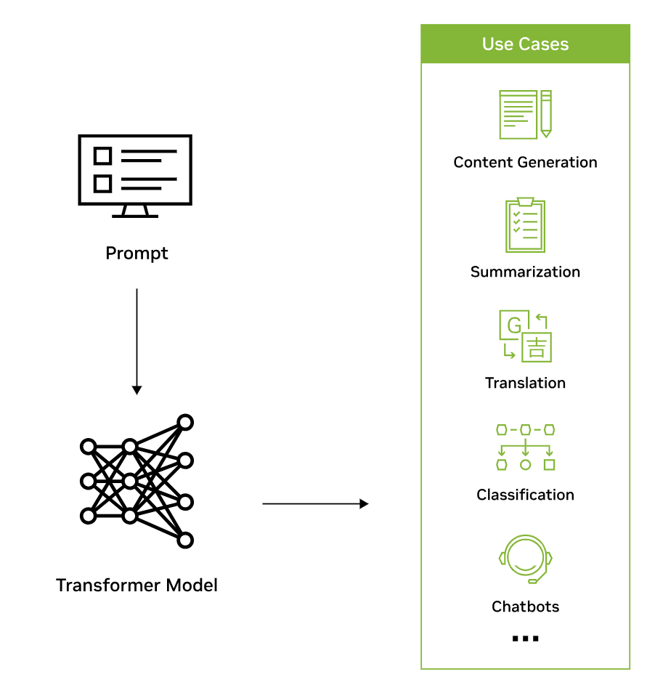
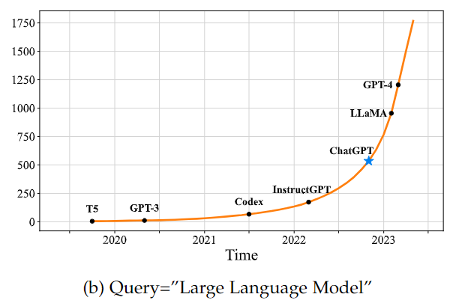
Large Language Models (LLMs)
Large Language Models (LLMs) are a type of generative AI that are trained on text and produce textual content
LLMs acquire the ability to achieve general-purpose language understanding & generation
by using massive amounts of data to learn billions of parameters during training
8.5 papers/day on arXiv that contain “large language model” in title or abstract
Credits: Nvidia
Zhao et al. A Survey of Large Language Models, arXiv, 2023
Notes:
DALL-E can create original, realistic images and art from a text description as well as combine concepts, attributes, and styles
Dall-E is a popular example of generative image AI (text2image)

Slide 50
Time and LLMs
How to design LLMs that would pay more attention on temporal aspects in text?
Pretraining corpora?
Pretraining tasks?
Attention mechanism change?
…

Slide 51
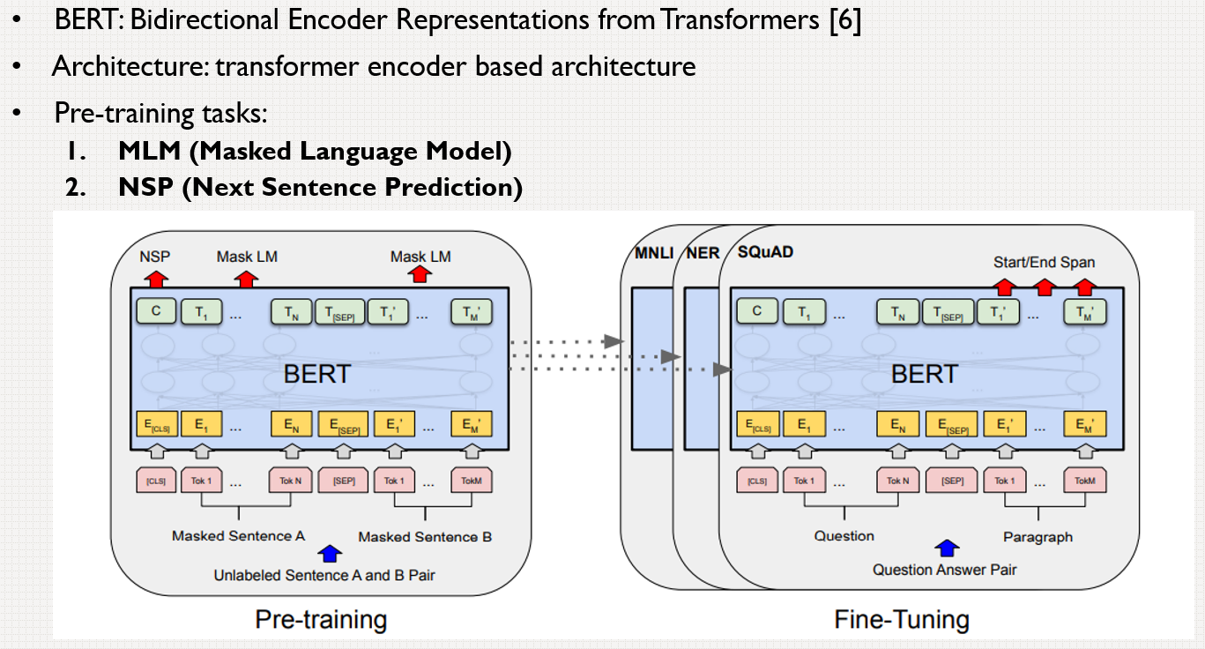
Domain-specific LLMs
Some language models use specialized pre-training tasks for particular tasks\domains:
SpanBERT: replaces Masked Language Model (MLM) with Span Masking to obtain SOTA performance on span selection tasks such as machine reading comprehension
SentiLARE: extends MLM to label-aware MLM, and obtains new SOTA performance on sentiment analysis tasks
BERT
Existing language models do not seem to explicitly utilize temporal aspects of text

Slide 52
Pre-trained Language Models
Some language models are proposed using specific pre-training tasks or corpora, that show significant improvements on particular tasks or domains:
SpanBERT: replaces Masked Language Model (MLM) with Span Masking, and obtains new SOTA performance on span selection tasks such as machine reading comprehension.
SentiLARE: extend the MLM to Label-Aware MLM, and obtains new SOTA performance on a variety of sentiment analysis tasks.
BioBERT, SciBERT, ClinicalBERT: are proposed for biomedical domain, scientific domain and clinical domain, respectively
Existing language models are incapable of utilizing the important temporal signals such as document timestamps
Our final objective is to develop a language model that can construct time-aware language representation by utilizing two temporal signals

Slide 53
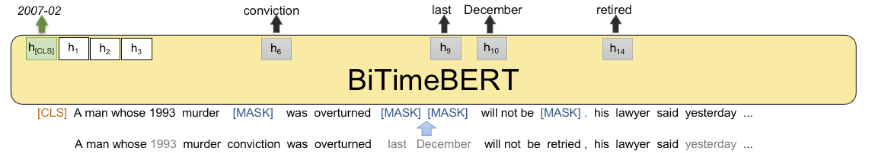
BiTimeBERT
Architecture: transformer encoder
Objective: enhance language representations with temporal information
Pre-training dataset: NYT Corpus (1.8 million news)
Novel pre-training tasks:
Time-aware Masked Language Modeling (TAMLM)
Explicitly introduces temporal expressions in text during pre-training: mask 30% of temporal expressions in text
Document Dating (DD)
Incorporates document timestamp information during pre-training: predict timestamp at given granularity
J. Wang, A. Jatowt, M. Yoshikawa, Y. Cai: BiTimeBERT: Extending Pre-Trained Language Representations with Dual-Type Temporal Information. SIGIR 2023

Slide 54
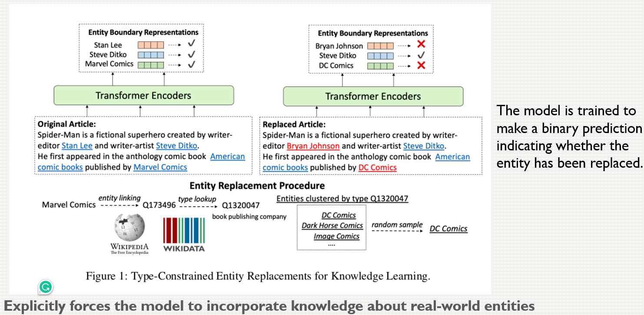

TIR Task (not included in the final model)
TIR: Temporal Information Replacement
50% of temporal expressions are replaced by other temporal expressions of the same granularity.
The task is to predict whether the temporal expressions are replaced.
WLKM: Weakly Supervised Knowledge-Pretrained
Language Model [1]
[1] Xiong, Wenhan, et al. Pretrained encyclopedia: Weakly supervised knowledge-pretrained language model. arXiv preprint arXiv:1912.09637 (2019).

Slide 55

Datasets
5 temporal datasets of different character
Event time estimation
Document timestamping (dating)
Temporal question answering

Slide 56




Performance of BiTimeBERT
Event dating
Document timestamping
Temporal question answering
Sentence dating
J. Wang, A. Jatowt, M. Yoshikawa, Y. Cai: BiTimeBERT: Extending Pre-Trained Language Representations with Dual-Type Temporal Information. SIGIR 2023

Slide 57

Conclusions
Temporal reasoning tasks related to temporal commonsense reasoning in text:
Temporal validity duration prediction
Temporal validity reassessment
Temporal validity change prediction
Incorporating time into LLMs
Future work:
Creation of large-scale, complex datasets
Extension to reason about future
Prompt engineering techniques for improving temporal reasoning of LLMs

Slide 58
Context-based Temporal Validity Prediction: Temporal Natural Language Inference
Estimate if an action expressed in a sentence would continue or cease to take place in view of additional context
Task: classification
Classes: supported invalidated, neutral
Size: 10k
Source: sentences from image captions
Generation way: crowdsourcing
Taishi Hosokawa, Adam Jatowt, Kazunari Sugiyama: Temporal Natural Language Inference: Evidence-based Evaluation of Temporal Text Validity, ECIR 2023

Slide 59
Thank you!

Slide 63
Introduction

Slide 64
Large Language Models (LLMs)
Large Language Models (LLMs) are a type of generative AI that are trained on text and produce textual content
ChatGPT is a popular example of generative text AI
LLMs acquire the ability to achieve general-purpose language understanding & generation
by using massive amounts of data to learn billions(?) of parameters during training
8.5 papers/day on arXiv that contain “large language model” in title or abstract
Credits: Nvidia
Zhao et al. A Survey of Large Language Models, arXiv, 2023
Notes:
DALL-E can create original, realistic images and art from a text description as well as combine concepts, attributes, and styles
Dall-E is a popular example of generative image AI (text2image)

Slide 65

A Timeline of Existing LLMs with Size >10B Parameters
Zhao, Wayne Xin, et al. "A survey of large language models." arXiv preprint arXiv:2303.18223 (2023).

Slide 66

Open source world, e.g.: LLaMa legacy
Zhao, Wayne Xin, et al. "A survey of large language models." arXiv preprint arXiv:2303.18223 (2023).
Notes:
Introduce Llama more…who made it, how many parameters when…

Slide 67
Effect of Scale: Emergent Abilities of Large Language Models
Abilities that cannot be predicted by extrapolating performance improvements
Models gain suddenly good performance on some tasks once the scale exceeds a certain range
One explanation is that complex tasks with multiple steps cannot be handled by models unless they are large enough to handle every step..
Wei, Jason, et al. "Emergent abilities of large language models." arXiv preprint arXiv:2206.07682 (2022).

Slide 68

In-context learning in very large models
Very large language models (e.g., GPT-3) seem to perform some kind of learning without traditional machine learning procedures simply from examples you provide within their contexts (prompts)…
Brown, Tom, et al. "Language models are few-shot learners." Advances in neural information processing systems 33 (2020): 1877-1901.

Slide 69


However, there are (still) some problems..
Yejin Choi, Why AI is incredibly smart and shockingly stupid?, TED talk, April 2023
Notes:
https://wenting-zhao.github.io/complex-reasoning-tutorial/slides/1.pdf

Slide 70


And dangers..
Emily M. Bender, et al. On the Dangers of Stochastic Parrots: Can Language Models Be Too Big? In Proceedings of the 2021 ACM Conference on Fairness, Accountability, and Transparency (FAccT '21). 610–623.
https://time.com/collection/time100-ai/6308275/emily-m-bender/
Notes:
The past 3 years of work in NLP have been characterized by the development and deployment of ever larger language models, especially for English. BERT, its variants, GPT-2/3, and others, most recently Switch-C, have pushed the boundaries of the possible both through architectural innovations and through sheer size.
Using these pretrained models and the methodology of fine-tuning them for specific tasks, researchers have extended the state of the art on a wide array of tasks as measured by leaderboards on specific benchmarks for English. In this paper, we take a step back and ask: How big is too big?
What are the possible risks associated with this technology and what paths are available for mitigating those risks? We provide recommendations including weighing the environmental and financial costs first, investing resources into curating and carefully documenting datasets rather than ingesting everything on the web, carrying out pre-development exercises evaluating how the planned approach fits into research and development goals and supports stakeholder values, and encouraging research directions beyond ever larger language models.
The paper and subsequent events resulted in Gebru and Mitchell losing their jobs at Google, and a subsequent protest by Google employees.

Slide 71
Pause Giant AI Experiments: An Open Letter
https://futureoflife.org/open-letter/pause-giant-ai-experiments/
“We call on all AI labs to immediately pause for at least 6 months the training of AI systems more powerful than GPT-4”
“AI labs and independent experts should use this pause to jointly develop and implement a set of shared safety protocols for advanced AI design and development that are rigorously audited and overseen by independent outside experts. …This does not mean a pause on AI development in general, merely a stepping back from the dangerous race to ever-larger unpredictable black-box models with emergent capabilities.”
“The letter addresses none of the ongoing harms from these systems, including
1) worker exploitation and massive data theft to create products that profit a handful of entities,
2) explosion of synthetic media in the world, which both reproduces systems of oppression and endangers our information ecosystem, and
3) concentration of power in the hands of a few people which exacerbates social inequities.”
https://www.dair-institute.org/blog/letter-statement-March2023/
Notes:
On Tuesday March 28, the Future of Life Institute published a letter asking for a six-month minimum moratorium on "training AI systems more powerful than GPT-4," signed by more than 2,000 people, including Turing award winner Yoshua Bengio and one of the world’s richest men, Elon Musk.
While there are a number of recommendations in the letter that we agree with (and proposed in our 2021 peer-reviewed paper known informally as "Stochastic Parrots"), such as "provenance and watermarking systems to help distinguish real from synthetic" media, these are overshadowed by fearmongering and AI hype, which steers the discourse to the risks of imagined "powerful digital minds" with "human-competitive intelligence." Those hypothetical risks are the focus of a dangerous ideology called longtermism that ignores the actual harms resulting from the deployment of AI systems today. The letter addresses none of the ongoing harms from these systems, including 1) worker exploitation and massive data theft to create products that profit a handful of entities, 2) the explosion of synthetic media in the world, which both reproduces systems of oppression and endangers our information ecosystem, and 3) the concentration of power in the hands of a few people which exacerbates social inequities.
While we are not surprised to see this type of letter from a longtermist organization like the Future of Life Institute, which is generally aligned with a vision of the future in which we become radically enhanced posthumans, colonize space, and create trillions of digital people, we are dismayed to see the number of computing professionals who have signed this letter, and the positive media coverage it has received. It is dangerous to distract ourselves with a fantasized AI-enabled utopia or apocalypse which promises either a "flourishing" or "potentially catastrophic" future [1]. Such language that inflates the capabilities of automated systems and anthropomorphizes them, as we note in Stochastic Parrots, deceives people into thinking that there is a sentient being behind the synthetic media. This not only lures people into uncritically trusting the outputs of systems like ChatGPT, but also misattributes agency. Accountability properly lies not with the artifacts but with their builders.
What we need is regulation that enforces transparency. Not only should it always be clear when we are encountering synthetic media, but organizations building these systems should also be required to document and disclose the training data and model architectures. The onus of creating tools that are safe to use should be on the companies that build and deploy generative systems, which means that builders of these systems should be made accountable for the outputs produced by their products. While we agree that "such decisions must not be delegated to unelected tech leaders," we also note that such decisions should not be up to the academics experiencing an "AI summer," who are largely financially beholden to Silicon Valley. Those most impacted by AI systems, the immigrants subjected to "digital border walls," the women being forced to wear specific clothing, the workers experiencing PTSD while filtering outputs of generative systems, the artists seeing their work stolen for corporate profit, and the gig workers struggling to pay their bills should have a say in this conversation.
Contrary to the letter’s narrative that we must "adapt" to a seemingly pre-determined technological future and cope "with the dramatic economic and political disruptions (especially to democracy) that AI will cause," we do not agree that our role is to adjust to the priorities of a few privileged individuals and what they decide to build and proliferate. We should be building machines that work for us, instead of "adapting" society to be machine readable and writable. The current race towards ever larger "AI experiments" is not a preordained path where our only choice is how fast to run, but rather a set of decisions driven by the profit motive. The actions and choices of corporations must be shaped by regulation which protects the rights and interests of people.
It is indeed time to act: but the focus of our concern should not be imaginary "powerful digital minds." Instead, we should focus on the very real and very present exploitative practices of the companies claiming to build them, who are rapidly centralizing power and increasing social inequities.
They have called for a pause on the training of any AI systems more powerful than GPT-4, OpenAI’s latest large language model (LLM), which underpins its wildly popular chatbot ChatGPT.
The letter, published on Wednesday, coincided with the release of a separate report from Goldman Sachs, which estimates that 300 million full-time jobs could be exposed to generative AI globally.
The explosion of interest in AI ushered in by the likes of ChatGPT and DALL-E, an image generator, has also seen many questions raised about the ethics and impact of the new powerful tools.
Even Sam Altman, the CEO of ChatGPT’s creator OpenAI, has raised the alarm a number of times about the sudden rise of AI, recently stating that the world may not be “that far from potentially scary” AI tools.
Responding to that warning at the time, some AI experts told Euronews Next that rather than “potentially scary” applications being around the corner, we are currently living in a “dystopic present” thanks to the proliferation of AI.
Sam Altman says 'potentially scary' AI is on the horizon. This is what keeps AI experts up at night
Sarah Myers West, Managing Director of the AI Now Institute, said that today "in many senses, that’s already where we are," with AI systems exacerbating "longstanding patterns of inequality," especially in areas such as job applications and education.
The open letter, released on March 28, had 1,123 signatures at the time of this article’s publication, including the author Yuval Noah Harari, and the Turing prize winner Yoshua Bengio.
It states that AI could be about to profoundly change the trajectory of life on Earth, and it “should be planned for and managed with commensurate care and resources” - something which the authors argue isn’t happening.
Warning that machines could “flood our information channels with propaganda,” or take away “all the jobs,” making humans “obsolete,” the authors ask: “Should we risk loss of control of our civilisation?”
They then call for oversight, so that these decisions are not left in the hands of tech leaders
Sarah Myers West, Managing Director of the AI Now Institute, said that today "in many senses, that’s already where we are," with AI systems exacerbating "longstanding patterns of inequality," especially in areas such as job applications and education.
The open letter, released on March 28, had 1,123 signatures at the time of this article’s publication, including the author Yuval Noah Harari, and the Turing prize winner Yoshua Bengio.
It states that AI could be about to profoundly change the trajectory of life on Earth, and it “should be planned for and managed with commensurate care and resources” - something which the authors argue isn’t happening.
Warning that machines could “flood our information channels with propaganda,” or take away “all the jobs,” making humans “obsolete,” the authors ask: “Should we risk loss of control of our civilisation?”
They then call for oversight, so that these decisions are not left in the hands of tech leaders.
This oversight should include shared safety protocols that are overseen by independent experts.
AI developers should also work with policymakers to “dramatically accelerate development of robust AI governance systems,” they add.
Forget ChatGPT. These top AI tools will revolutionise the way you work
‘300 million jobs exposed’
A memo from multinational investment bank Goldman Sachs meanwhile has revealed the large-scale economic impact of AI, according to the bank’s research team.
They estimate that AI could take over up to a quarter of all current work, which would expose the equivalent of 300 million full-time jobs to automation.
The good news, according to the memo, is that “worker displacement from automation has historically been offset by creation of new jobs, and the emergence of new occupations following technological innovations accounts for the vast majority of long-run employment growth”.
The labour cost-savings and higher productivity for non-displaced workers could mean “a productivity boom that raises economic growth substantially,” it added.
For example, they estimate a boost to global labour productivity that could raise annual global GDP by 7 per cent.

Slide 72


In-context Learning
Zero-shot learning
One-shot learning
Few-shot learning
https://medium.com/@haifengl/a-tutorial-to-llm-f78dd4e82efc

Slide 73
Time & Text
Time is of the essence:
A key aspect of stories, events, narrative documents, message streams, etc.
Can determine if documents are relevant
Can tell how the different story pieces should be combined
Can help in correct text understanding & and information extraction…
…
So far, the NLP and IR communities placed rather limited focus on research towards understanding and utilizing temporal aspects of text…
It is unclear how well can LLMs perform tasks of temporal nature

Slide 74
Two Main Types of Temporal Knowledge
Temporal Commonsense Knowledge
E.g., visiting a doctor is after breaking the leg rather than before
E.g., going on holiday takes longer than going for a walk
Temporal Factual Knowledge
E.g., Barack Obama was the US president from 2009 to 2017
E.g., Hiroshima and Nagasaki bombings were after the Attack on Pearl Harbor
Notes:
570k human-written English sentence pairs manually labeled for balanced classification with the labels entailment, contradiction, and neutral.

Slide 75
Temporal Commonsense Reasoning
Raghav Jain, Daivik Sojitra, Arkadeep Acharya, Sriparna Saha, Adam Jatowt, Sandipan Dandapat: Do Language Models Have a Common Sense regarding Time? Revisiting Temporal Commonsense Reasoning in the Era of Large Language Models, Proc. of EMNLP 2023

Slide 76
Research Questions
What is the general performance of LLMs in Temporal Commonsense Reasoning?
Are the models proficient across all different temporal tasks?
Which temporal commonsense tasks present the greatest challenges?
Does the ambiguity in temporal expressions affect model performance?
How do models perform when they need to reason about long time frames, multiple events, or past and future events?

Slide 77

Datasets
MC-TACO (Zhou et al., 2019):
Given a context, a question, and a candidate response, the task is to determine whether the candidate answer is "yes" (plausible) or "no" (implausible)
TimeDial (Qin et al., 2021):
Multiple-choice cloze task featuring over 1.1K carefully curated dialogues. The dialogues require an understanding of temporal commonsense concepts interwoven with the presented events
TNLI (Hosokawa et al., 2023):
Temporal Natural Language Inference (TNLI) – ascertain the validity of textual content by using additional associated content as corroborating evidence
WikiHow (Zhang et al., 2020):
Given a goal and a number of steps, a system has to determine if the steps are in the correct temporal order
BIG-bench (Srivastava et al., 2023):
Provided with a sequence of finished events, each with its defined timeframe, the model needs to determine when an individual might have been available for an unscheduled activity.
TimeQA (Chen et al., 2021):
A series of time-sensitive question-answer pairs. Answering these questions involves understanding and reasoning within a longer context that requires temporal comprehension

Slide 78


Example Questions from MC-Taco

Slide 79


Slide 80



Large Language Models
Large autoregressive models:
GPT-J,
GPT Neo,
LLaMA
OPT
Supervised instruction finetuned models:
FLAN-T5,
BLOOMZ,
Dolly
GPT-3.5
Code generation models:
SantaCoder
CodeGen2

Slide 81





Results: General Model Performance

Slide 82




Results: Task-based Analysis

Slide 83

Temporal Aspect-based Analysis

Slide 84




Results: Temporal Aspect-based Analysis

Slide 85

Temporal Aspect-based Analysis

Slide 86



Results: Temporal Aspect-based Analysis

Slide 87
Natural Language Inference (aka. Text Entailment)
Natural Language Inference (NLI): task of determining the inference relation between two short texts
3 classes:
Entailment
Contradiction
Neutral
Premise
Hypothesis
Relation
A soccer game with multiple males playing. | Some men are playing a sport. | Entailment
A black race car starts up in front of a crowd of people. | A man is driving down a lonely road. | Contradiction
A smiling costumed woman is holding an umbrella. | A happy woman in a fairy costume holds an umbrella. | Neutral
https://nlp.stanford.edu/projects/snli/

Slide 89
Analyzing Temporal Reasoning Abilities of LLMs [EMNLP‘23]
Raghav Jain, Daivik Sojitra, Arkadeep Acharya, Sriparna Saha, Adam Jatowt, Sandipan Dandapat: Do Language Models Have a Common Sense regarding Time? Revisiting Temporal Commonsense Reasoning in the Era of Large Language Models, Proc. of EMNLP 2023

Slide 90
Dataset examples

Slide 91
Incorporating Time into LLMs

Slide 92
Domain-specific LLMs
Some language models use specialized pre-training tasks for particular tasks\domains:
SpanBERT: replaces Masked Language Model (MLM) with Span Masking to obtain SOTA performance on span selection tasks such as machine reading comprehension
SentiLARE: extends MLM to label-aware MLM, and obtains new SOTA performance on sentiment analysis tasks
BERT
Existing language models do not seem to explicitly utilize temporal aspects of text

Slide 93
Pre-trained Language Models
Some language models are proposed using specific pre-training tasks or corpora, that show significant improvements on particular tasks or domains:
SpanBERT: replaces Masked Language Model (MLM) with Span Masking, and obtains new SOTA performance on span selection tasks such as machine reading comprehension.
SentiLARE: extend the MLM to Label-Aware MLM, and obtains new SOTA performance on a variety of sentiment analysis tasks.
BioBERT, SciBERT, ClinicalBERT: are proposed for biomedical domain, scientific domain and clinical domain, respectively
Existing language models are incapable of utilizing the important temporal signals such as document timestamps
Our final objective is to develop a language model that can construct time-aware language representation by utilizing two temporal signals

Slide 94
BiTimeBERT
Architecture: transformer encoder
Objective: enhance language representations with temporal information
Pre-training dataset: NYT Corpus (1.8 million news)
Novel pre-training tasks:
Time-aware Masked Language Modeling (TAMLM)
Explicitly introduces temporal expressions in text during pre-training: mask 30% of temporal expressions in text
Document Dating (DD)
Incorporates document timestamp information during pre-training: predict timestamp at given granularity
J. Wang, A. Jatowt, M. Yoshikawa, Y. Cai: BiTimeBERT: Extending Pre-Trained Language Representations with Dual-Type Temporal Information. SIGIR 2023

Slide 95
TIR Task (not included in the final model)
TIR: Temporal Information Replacement
50% of temporal expressions are replaced by other temporal expressions of the same granularity.
The task is to predict whether the temporal expressions are replaced.
WLKM: Weakly Supervised Knowledge-Pretrained
Language Model [1]
[1] Xiong, Wenhan, et al. Pretrained encyclopedia: Weakly supervised knowledge-pretrained language model. arXiv preprint arXiv:1912.09637 (2019).

Slide 96
Datasets
5 temporal datasets of different character
Event time estimation
Document timestamping (dating)
Temporal question answering

Slide 97
Performance of BiTimeBERT
Event dating
Document timestamping
Temporal question answering
Sentence dating
J. Wang, A. Jatowt, M. Yoshikawa, Y. Cai: BiTimeBERT: Extending Pre-Trained Language Representations with Dual-Type Temporal Information. SIGIR 2023

Slide 98
From BERT to Time-aware Bert
Some language models use specialized pre-training tasks for particular tasks\domains, e.g.:
SpanBERT: replaces Masked Language Model (MLM) with Span Masking to obtain SOTA performance on span selection tasks such as machine reading comprehension
SentiLARE: extends MLM to label-aware MLM, and obtains new SOTA performance on sentiment analysis tasks
BERT
Existing language models do not utilize temporal aspects of text

Slide 99
Temporal Validity Problems

Slide 100
Hosokawa et al.
CoTak
Temporal Validity Change Prediction
Archival
Lynden et al.: Commonsense Temporal Action Knowledge (CoTAK) Dataset, CIKM 2023

Slide 101
Context-based Temporal Validity Prediction: Temporal Natural Language Inference
Estimate if an action expressed in a sentence would continue or cease to take place in view of additional context
Task: classification
Classes: supported invalidated, neutral
Size: 10k
Source: sentences from image captions
Generation way: crowdsourcing
Taishi Hosokawa, Adam Jatowt, Kazunari Sugiyama: Temporal Natural Language Inference: Evidence-based Evaluation of Temporal Text Validity, ECIR 2023

Slide 102
Context-based Temporal Validity Prediction: Temporal Natural Language Inference

Slide 103
Temporal Validity Change Prediction
Estimate if an action expressed in a sentence would increase or decrease the temporal validity of another sentence
Task: classification
Classes: decreased, increased, neutral
Size: 5k
Source: sentences from Twitter
Generation way: crowdsourcing

Slide 104
Temporal Validity Change Prediction
User Tweet Stream
Target tweet
Classifier
Does any of the follow-up tweet render the original tweet obsolete?
Follow-up tweet
(select one)
“I have a doctors appt in 10 minutes which means I might have to wait for an hour”
“Tick tock. This is always so boring, no one ever tells me how long I am going to be here.”
No change in expected validity.
“The doctor was actually on time for once, so glad the visit is going quickly”
Changes the expected validity (Decreased)
“The doctor got called away on an emergency. Will have to reschedule later this week.”
Changes the expected validity (Increased)

Slide 105
Temporal Validity related Datasets

Slide 106
Time-related inference in natural language
S1: I am cooking pasta Bolonese for the first time
S2: The water is not hot yet
S1: I am cooking pasta Bolonese for the first time
S2: It was really tasty and I need a rest now
In which case, S2 impies the end of action expressed in S1?

Slide 107

Topic 1: Temporal commonsense reasoning about actions
Temporal commonsense reasoning (either task):
Temporal validity change prediction
Dataset:
>5k sentence pairs with their crowdsourced labels
Stationarity prediction
Dataset:
>1.5k sentences with stational, non-stational labels
+ other datasets that can be of help:
G. Wenzel, A. Jatowt, Temporal validity change prediction (under review at ACL2024)
G. Wenzel, A. Jatowt, An Overview Of Temporal Commonsense Reasoning and Acquisition: https://arxiv.org/abs/2308.00002

Slide 108
Estimating Temporal Validity
Assume you read the following sentences in a newspaper published 1 month ago:
“Chancellor of Austria is visiting Japan."
“Japan is a member of United Nations.”
Which would you consider still as true?
Time-based Inference
msg C
t
Is C still
valid?
Axel Almquist, Adam Jatowt: Towards Content Expiry Date Determination: Predicting Validity Periods of Sentences. ECIR 2019, pp. 86-101

Slide 109
Temporal Validity Classes
Within a few hours | “So Michi, Audrey, Joel and myself are all hanging out in Linda’s basement.”
Within a few days | “School starts at a later time on Wednesday but that’s no big deal.”
Within a few weeks | “I am taking a course on learning how to use the program 3d studio max.”
Within a few months | “I am also playing a gig with the new millennium string orchestra at the beginning of next month.”
Within a few years or more | “The middle eastern nation of Israel is planning to expand its settlements, its housing areas in the west bank.”
Axel Almquist, Adam Jatowt: Towards Content Expiry Date Determination: Predicting Validity Periods of Sentences. ECIR 2019, pp. 86-101

Slide 110
Simple Approach for Estimating Temporal Validity
Features
Dataset
Axel Almquist, Adam Jatowt: Towards Content Expiry Date Determination: Predicting Validity Periods of Sentences. ECIR 2019, pp. 86-101

Slide 111
Estimating Temporal Validity
Assume you read the following sentences in a newspaper published 1 month ago:
“Chancellor of Austria is visiting Japan."
“Japan is a member of United Nations.”
Which would you consider still as true?
Time-based Inference
msg C
t
Is C still
valid?
Assume you read the following messages/posts of given user:
Post 1: "I am taking a walk.“
Post 2: “Getting a cup of coffee for take-away.”
Post 3: “Just started preparing dinner.”
Is message 1 still true after reading message 2?
How about after reading post 3?
Premise-based Inference
msg A
msg B
Is A still
valid?
Axel Almquist, Adam Jatowt: Towards Content Expiry Date Determination: Predicting Validity Periods of Sentences. ECIR 2019, pp. 86-101
Taishi Hosokawa, Adam Jatowt, Kazunari Sugiyama: Temporal Natural Language Inference: Evidence-based Evaluation of Temporal Text Validity, ECIR 2023

Slide 112
Premise-based Temporal Validity Inference: Posing the Task as a Natural Language Inference
Validity estimation of hypothesis in view of information contained in premise
Three classes:
Supported, Invalidated, Unknown
Hypothesis | Premise | Label
A small Asian street band plays in a city park. | Their performance pulls a large crowd as they used some new tunes and songs today. | Supported
A woman in blue rain boots is eating a sandwich outside. | She takes off her boots in her house. | Invalidated
A man jumping a rail on his skateboard. | His favorite food is pizza. | Unknown

Slide 113

Premise-based Inference of Temporal Validity
https://homes.cs.washington.edu/~msap/atomic/
Taishi Hosokawa, Adam Jatowt, Kazunari Sugiyama: Temporal Natural Language Inference: Evidence-based Evaluation of Temporal Text Validity, ECIR 2023
Notes:
There are different KGs such as FrameNet, WikiHow, Howto100m, or VerbNet that could be utilized for our task, but we think that ATOMIC-2020 is the most appropriate to achieve our goal due to its temporal common-sense knowledge contained as well as usability in terms of its format.
It is the atlas of everyday commonsense reasoning, organized through 877k textual descriptions of inferential knowledge

Slide 114


Temporal Validity Adjustment
User Tweet Stream
Target tweet
How does the follow-up tweet change the expected temporal validity period of target tweet?
Classifier
Follow-up tweet
(select one)
“I have a doctors appt in 10 minutes which means I might have to wait for an hour”
“Tick tock. This is always so boring, no one ever tells me how long I am going to be here.”
No change in expected validity.
“The doctor was actually on time for once, so glad the visit is going quickly”
Changes the expected validity (Decreased)
“The doctor got called away on an emergency. Will have to reschedule later this week.”
Changes the expected validity (Increased)
Transformer - CTA (BERT), 0.228 EM Transformer - RoBERTa, 0.250 EM ChatGPT, 0.293 EM Transformer - TacoLM (BERT), 0.309 EM Transformer - BERT, 0.362 EM Transformer - BERT (+ Multitask), 0.395 EM
Siamese - BERT, 0.488 EM Siamese - RoBERTa, 0.533 EM Siamese - RoBERTa (+ Multitask), 0.542 EM SelfExplain, 0.691 EM SelfExplain (+ Multitask), 0.702 EM

Slide 115
Conclusions
Temporal knowledge and reasoning capabilities of LLMs:
Analysis of temporal commonsense reasoning of LLMs
Analysis of temporal blind spots of LLMs
An approach for injecting time into LLM design (BiTimeBERT)
Novel temporal tasks and datasets for probing LLMs
Future work:
Creation of a large-scale, complex dataset of temporal knowledge including minor knowledge of the past
Prompt engineering techniques for boosting temporal reasoning and extraction of temporal knowledge

Slide 116
Thank you!
Special thanks to my collaborators:
Sriparna Saha, Raghav Jain, Jonnas Wallat, Avishek Anand, Georg Wenzel, Jiexin Wang,
Taishi Hosokawa, Kazunari Sugiyama, Steven Lynden, Kyoung-Sook Kim, Axel Almquist
“The limits of my language mean the limits of my world.”
—Ludwig Wittgenstein

Slide 118


Temporal Natural Language Inference: Evidence-based Evaluation of Temporal Text Validity
Taishi Hosokawa¹, Adam Jatowt², Kazunari Sugiyama³
¹Kyoto Univ., ²Univ. of Innsbruck, ³Osaka Seikei Univ.

Slide 119
Temporal Validity of Text (Prior Work)
Assume you read the following sentences in a newspaper published a month ago:
“Chancellor of Austria is visiting Ireland."
“Ireland is a member of United Nations.”
Which would you consider still as true?
Time-based Temporal Validity Inference
msg C
t
Is C still
valid?
Axel Almquist, Adam Jatowt: Towards Content Expiry Date Determination: Predicting Validity Periods of Sentences. ECIR 2019, pp. 86-101

Slide 120
Validity Classes – Information expiry DATE (PRIOR WORK)
Within a few hours | “So Michi, Audrey, Joel and myself are all hanging out in Linda’s basement.”
Within a few days | “School starts at a later time on Wednesday but that’s no big deal.”
Within a few weeks | “I am taking a course on learning how to use the program 3d studio max.”
Within a few months | “I am also playing a gig with the new millennium string orchestra at the beginning of next month.”
Within a few years or more | “The middle eastern nation of Israel is planning to expand its settlements, its housing areas in the west bank.”
Information
expiry period
Axel Almquist, Adam Jatowt: Towards Content Expiry Date Determination: Predicting Validity Periods of Sentences. ECIR 2019, pp. 86-101

Slide 121
LIME: https://github.com/marcotcr/lime

Slide 122
EXTENSION OF TEMPORAL VALIDITY PROBLEM
(CURRENT WORK)
Assume you read the following posts from the same user:
Post A: "I am taking a walk “
Post B: “Getting a cup of coffee for take-away”
Post C: “Just started preparing dinner”
Is the post A still true after reading post B?
How about after reading post C?

Slide 123
General Problem Statement
Predict whether information expressed in a natural language content remains valid after observing more evidence as subsequent content.
Evidence-based Temporal Validity Inference
Is the action still taking place in view of the newly added information?
msg A
msg B
Is A still
valid?

Slide 124
Example Applications
Story understanding: story reading comprehension improved by capturing implicit temporal information
Filtering microblogs: tweets selection on a timeline
Conversational support for chatbots
User tracking & analysis in SNS
Etc.

Slide 125
Natural Language Inference Datasets
Stanford Natural Language Inference (SNLI)
Bowman et al. (2015), 550k
First large annotated dataset
Multi-genre Natural Language Inference (MNLI)
Williams et al. (2018), 392k
Inspired by SNLI
Multi-genre source
Scitail
Khot et al. (2018)
Scientific questions
Notes:
570k human-written English sentence pairs manually labeled for balanced classification with the labels entailment, contradiction, and neutral.

Slide 126
Temporal Natural Language Inference (TLNI): Posing our Task as an Inference Problem
TNLI: validity estimation of hypothesis in view of information contained in premise
Three classes:
Supported, Invalidated, Unknown
Hypothesis | Premise | Label
A small Asian street band plays in a city park. | Their performance pulls a large crowd as they used some new tunes and songs today. | Supported
A woman in blue rain boots is eating a sandwich outside. | She takes off her boots in her house. | Invalidated
A man jumping a rail on his skateboard. | His favorite food is pizza. | Unknown

Slide 127

Related Work

Slide 128
Constructing Dataset
Hypotheses: randomly sampled 5k premises from SNLI
Premises: created through crowdsourcing with AMT for each of 3 classes and subject to manual verification
Result: 10,659 sentence pairs balanced over 3 classes
Notes:
5fold cross va
Since it has been pointed out that the number of words in each sentence varies greatly depending on the label in some datasets of NLI [Khot et al., 2018], we examined the average number of words in each sentence validation

Slide 129
ATOMIC Knowledge Base
Commonsense Reasoning Knowledge Base (1.33M commonsense knowledge tuples and 23 relations)
Includes ConceptNet knowledge
ConceptNet - the most commonly used commonsense
knowledge base about physical entities
9 if-then relation classes
cause
reaction
intention
effect
…
Many physical and event-centered relations
“IsAfter”, “IsBefore”, “HasSubEvent”, “HinderedBy”
https://homes.cs.washington.edu/~msap/atomic/
Notes:
There are different KGs such as FrameNet, WikiHow, Howto100m, or VerbNet that could be utilized for our task, but we think that ATOMIC-2020 is the most appropriate to achieve our goal due to its temporal common-sense knowledge contained as well as usability in terms of its format.
It is the atlas of everyday commonsense reasoning, organized through 877k textual descriptions of inferential knowledge

Slide 130
Proposed Model
Learns information from a knowledge base
Uses embeddings for representing data in knowledge base
Knowledge base: tuples <head entity, relation, tail entity>
Combines text-based method (e.g., BERT) with knowledge-based encoding method (e.g., TransE)
Embedding in knowledge bases
(TransE):
head entity + relation = tail entity
Bordes, A., Usunier, N., Garcia-Duran, A., Weston, J., & Yakhnenko, O. (2013). Translating embeddings for modeling multi-relational data. Advances in neural information processing systems, 26.

Slide 131
Initial Analysis using NLI-based Pretraining
NLI-based pretraining improves Siamese network’s performance
NLI-based pretraining does not improve the result of Self-Explaining model (SOTA model for NLI)
NLI-related information may be already included during the pre-training for Self-Explaining model
SUPPORTED = Entailment (NLI)
INVALIDATED = Contradiction (NLI)
UNKNOWN = Neutral (NLI)
Sun, Zijun, et al. "Self-explaining structures improve nlp models." arXiv preprint arXiv:2012.01786 (2020).
Notes:
Span based attention on Roberta model (pretraining is different on more data due to Roberta) and many parameters are tuned and loss functions and tasks
The key point of the proposed framework is to put an additional layer, as is called by the interpretation layer, on top of any existing NLP model. This layer aggregates the information for each text span, which is then associated with a specific weight, and their weighted combination is fed to the softmax function for the final prediction. The proposed model comes with the following merits: (1) span weights make the model self-explainable and do not require an additional probing model for interpretation; (2) the proposed model is general and can be adapted to any existing deep learning structures in NLP; (3) the weight associated with each text span provides direct importance scores for higher level text units such as phrases and sentences.
Generally, pre-training with NLI datasets improves accuracy in many downstream tasks

Slide 132


Proposed Model
Learns information from a knowledge base
Uses embeddings for representing data in knowledge base
Knowledge base: tuples <head entity, relation, tail entity>
Combines text-based method (e.g., BERT) with knowledge-based encoding method (e.g., TransE)
Embedding in knowledge bases
(TransE):
head entity + relation = tail entity
Bordes, A., Usunier, N., Garcia-Duran, A., Weston, J., & Yakhnenko, O. (2013). Translating embeddings for modeling multi-relational data. Advances in neural information processing systems, 26.

Slide 133
Outline of Proposed Model
Encoder Fully Based on Contextual Information
transform to the same dimension by 1 feedforward layer
Encoder Based on Knowledge Base
concatenation of embeddings of hypothesis and premise
transform to the same dimension by 1 feedforward layer

Slide 134
TransE
Embedding for Knowledge Bases
head entity + relation = tail entity
inspired by word embedding methods

Slide 135
TransE for Sentences
Concept embedding: sentence encoder + weight W
Relation embedding: same as TransE

Slide 136
Experiments
Siamese Network with Tanh Layers and GloVe
SBERT + FFN
BERT
Self-Explaining Model with RoBERTa
Siamese + NLI-pretraining
Self-Explaining Model + NLI-pretraining
Siamese + TransE
Self-Explaining Model + TransE

Slide 137
Self-Explaining Model (SOTA for NLI)
Attention-Like Layer on Top of Arbitrary Encoder
Combination of Span Infor Collecting (SIC) Layer and Interpretation Layer
SIC Layer
Calculate word span embedding
Interpretation Layer
Aggregates span embeddings
State-of-the-Art in SNLI
Notes:
Span based attention on Roberta model (pretraining is different on more data due to Roberta) and many parameters are tuned and loss functions and tasks

Slide 138
Experimental Results
Ground truth
Self-explaining model performs best
Siamese + TransE performs better than Siamese
Self-explaining + TransE has almost same accuracy as self-explaining
Predicted
Siamese
Tested variants of TransE
(in conjunction with Self-Explaining model)
Siamese + TransE
Incorporating TransE to Siamese net helps to more correctly determine SUPPORTED and UNKNOWN classes (improvement of 28% and 6.5%), while only slightly confusing the INVALIDATED class (decrease of 1.4%)

Slide 139
Siamese Network
Contains two or more identical networks
Widely used in two-sentence input tasks such as NLI
The used one consists of GloVe and Tanh Layer

Slide 140
Bidirectional Encoder Representation of Transformer (BERT)
Large Pre-Trained Model
Significantly Better Performance in Various NLP Tasks

Slide 141
RoBERTa
Model: BERT
Change Pre-Training Methods
Dataset
Task
Hyperparameter

Slide 142
Sentence BERT (SBERT)
BERT for Sentence Comparison
BERT has been widely used, but it was unclear how accurate it is
BERT takes a lot of time to compare sentences if it is defined as a task
Fine-Tuned Using Siamese Architecture and NLI

Slide 143
Related Works
Natural Language Inference
McTaco
Zhou et al. (2019)
Validity Period Estimation
Almquist et al. (2019)

Slide 144
CONCLUSIONS
Approaching temporal validity of an unstructured text
Proposal of a novel task: evidence-based temporal validity inference
Created the first dataset for this task
Tested pretraining with standard NLI datasets
Introduced a model based on external knowledge base
Time-based Temporal Validity Inference
Evidence-based Temporal Validity Inference
C^{i}
C^{i}
C^{i+1}
Is C^{i} still
valid?
t
Is C^{i} still
valid?
https://github.com/t-hoso/temporal_natural_language_inference

Slide 145
FUTURE WORK
Extending to the case of multiple sequential sentences/messages
Developing genre-specific or domain-specific models (news, novels, medicine, law, etc.)
Extending to multi-modal datasets
Hybrid Temporal Validity Inference
C^{i}
C^{i+1}
Is C^{i} still
valid?
t
Notes:
A simple solution would divide T+PI subtask into TI and PI subtasks and solve them independently using their dedicated models to later combine the results of these two subtasks (e.g., by deciding the resulting class through the comparison of classification confidences). Of course, a joint model should perform better by combining the time and premise related information.
While the case of content about the past is similar to the one on the present (sentences describing past actions will be judged in the same way as present-related sentences, unless there is a clear time reference that indicates the past to be distant or information signaling action completion), the case of future actions such as plans or expectations is more complex and needs to be looked at more closely.
Here, a sequence of evidences needs to be considered to reason about the validity of hypothesis sentence.
instead of building generic models, and interesting option is to build domain-specific models such as ones trained on datasets for particular domains (e.g., human biographies, stories from distant time periods, or stories related to particular professions)
Additional: Considering periodical and long-lasting events

Slide 146
Thank you!
adam.jatowt@uibk.ac.at

Slide 147
Hybrid Temporal Validity Inference
C^{i}
C^{i+1}
t
Is C^{i} still valid?

Slide 148
Future Works
Improvement of the Result
Other embedding methods such as ComplEx
More relations in ATOMIC-2020 such as “HasSubEvent”
New Datasets
Our dataset focuses on actions and rather dynamic states
Dataset from other sources could broaden the application of the task
Extension of Task
Include time information
Notes:
talk about which one is genral/is one that I will work on

Slide 149
References
Berberich, K., Gupta, D.: Identifying time intervals for knowledge graph facts. In: Proceeding WWW 2018 Companion. In: Proceedings of the Web Conference 2018, Lyon, France, 23–27 April 2018, pp. 37–38 (2018)
Ling, X., Weld, D.: Temporal information extraction. In: Twenty-Fourth AAAI Conference on Artificial Intelligence (2010)
Sil, A., Cucerzan, S.: Temporal scoping of relational facts based on Wikipedia data. In: Proceedings of the Eighteenth Conference on Computational Language Learning, Baltimore, Maryland USA, 26–27 June 2014, pp. 109–118. Association for Computational Linguistics (2014)
Takemura, H., Tajima, K.: Tweet classification based on their lifetime duration published. In: Proceedings of CIKM 2012, Maui, pp. 2367–2370, October 2012
Talukdar, P.P., Wijaya, D., Mitchell, T.: Coupled temporal scoping of relational facts. In: Proceedings of the WSDM 2012, Seattle, USA, 8–12 February, pp. 73–82. ACM Press (2012)
Wang, Y., Zhu, M., Qu, L., Spaniol, M., Weikum, G.: Timely YAGO: harvesting, querying, and visualizing temporal knowledge from Wikipedia. In: EDBT 2010 Proceedings of the 13th International Conference on Extending Database Technology, Lausanne, Switzerland, 22–26 March, pp. 697–700 (2010)
Wang, Y., Yang, B., Qu, L., Spaniol, M.,Weikum, G.: Harvesting facts from textual web sources by constrained label propagation. In: CIKM 2011 Proceedings of the 20th ACM International Conference on Information and Knowledge Management, Glasgow, Scotland, UK, 24–28 October, pp. 837–846 (2011)

Slide 150
Discussion

Slide 151
tweet C^{i}
tweet C^{i}
tweet C^{i+1}
t
Is C^{i} still
valid?
Is C^{i} still
valid?

Slide 152
Examples of Classified Sentences
LIME: https://github.com/marcotcr/lime

Slide 153

Comparison Between Proposed Tasks and Others
Comparison
McTaco, NLI, Validity Period Estimation, TNLI

Slide 154

Analyzing Temporal Search User Practice on the Web
30 users searching for time-related information based on 6 topics (NTCiR Temporalia) each having 3 temporal subtopics (past, present, future)
H. Joho, A. Jatowt, R. Blanco: Temporal Information Searching Behaviour and Tactics, Information Processing and Management Journal (IPM) (2015), pp. 834-850

Slide 155



Analyzing Temporal Search User Practice on the Web
Number of saved pages and task experience
Percentage of visited
page categories
Time-related information orienteering
H. Joho, A. Jatowt, R. Blanco: Temporal Information Searching Behaviour and Tactics, Information Processing and Management Journal (IPM) (2015), pp. 834-850

Slide 157

https://towardsdatascience.com/transformers-intuitively-and-exhaustively-explained-58a5c5df8dbb
Notes:
https://towardsdatascience.com/transformers-intuitively-and-exhaustively-explained-58a5c5df8dbb

Slide 158


https://towardsdatascience.com/transformers-intuitively-and-exhaustively-explained-58a5c5df8dbb
Notes:
https://towardsdatascience.com/transformers-intuitively-and-exhaustively-explained-58a5c5df8dbb

Slide 159


https://towardsdatascience.com/transformers-intuitively-and-exhaustively-explained-58a5c5df8dbb
Notes:
https://towardsdatascience.com/transformers-intuitively-and-exhaustively-explained-58a5c5df8dbb

Slide 160


https://towardsdatascience.com/transformers-intuitively-and-exhaustively-explained-58a5c5df8dbb
Notes:
https://towardsdatascience.com/transformers-intuitively-and-exhaustively-explained-58a5c5df8dbb

Slide 161


https://towardsdatascience.com/transformers-intuitively-and-exhaustively-explained-58a5c5df8dbb
Notes:
https://towardsdatascience.com/transformers-intuitively-and-exhaustively-explained-58a5c5df8dbb

Slide 162

https://towardsdatascience.com/transformers-intuitively-and-exhaustively-explained-58a5c5df8dbb
Notes:
https://towardsdatascience.com/transformers-intuitively-and-exhaustively-explained-58a5c5df8dbb

Slide 163

https://towardsdatascience.com/transformers-intuitively-and-exhaustively-explained-58a5c5df8dbb
Notes:
https://towardsdatascience.com/transformers-intuitively-and-exhaustively-explained-58a5c5df8dbb

Slide 164

https://towardsdatascience.com/transformers-intuitively-and-exhaustively-explained-58a5c5df8dbb
Notes:
https://towardsdatascience.com/transformers-intuitively-and-exhaustively-explained-58a5c5df8dbb

Slide 165

https://towardsdatascience.com/transformers-intuitively-and-exhaustively-explained-58a5c5df8dbb
Notes:
https://towardsdatascience.com/transformers-intuitively-and-exhaustively-explained-58a5c5df8dbb

Slide 166

https://towardsdatascience.com/transformers-intuitively-and-exhaustively-explained-58a5c5df8dbb
Notes:
https://towardsdatascience.com/transformers-intuitively-and-exhaustively-explained-58a5c5df8dbb

Slide 167

https://towardsdatascience.com/transformers-intuitively-and-exhaustively-explained-58a5c5df8dbb
Notes:
https://towardsdatascience.com/transformers-intuitively-and-exhaustively-explained-58a5c5df8dbb

Slide 168
Temporal Aspect-based Analysis

Slide 169

The input embedding for a transformer is similar to previously discussed strategies; a word space embedder like word2vect converts all input words into a vector embedding. However, unlike recurrent strategies, transformers encode the entire input in one shot. As a result the encoder might lose information about the location of words in an input.
To resolve this, transformers also use positional encoders, which is a vector encoding information about where a particular word was in the sequence.
The vector used to encode the position of a word is added to the embedding of that word, creating a vector which contains both information about where that word is in a sentence, and the word itself. You might think “if your adding these wiggly waves to the embedding vector, wouldn’t that mask some of the meaning of the original embedding, and maybe confuse the model”? To that, I would say that neural networks (which the transformer employs for it’s learnable parameters) are incredibly good at understanding and manipulating smooth and continuous functions, so this is practically of little consequence for a sufficiently large model.

Slide 170
The input embedding for a transformer is similar to previously discussed strategies; a word space embedder like word2vect converts all input words into a vector embedding.
However, unlike recurrent strategies, transformers encode the entire input in one shot. As a result, the encoder might lose information about the location of words in an input.
To resolve this, transformers also use positional encoders, which is a vector encoding information about where a particular word was in the sequence.
The vector used to encode the position of a word is added to the embedding of that word, creating a vector which contains both information about where that word is in a sentence, and the word itself.
You might think “if your adding these wiggly waves to the embedding vector, wouldn’t that mask some of the meaning of the original embedding, and maybe confuse the model”? To that, I would say that neural networks (which the transformer employs for it’s learnable parameters) are incredibly good at understanding and manipulating smooth and continuous functions, so this is practically of little consequence for a sufficiently large model.
https://arxiv.org/pdf/1706.03762.pdf
Notes:
The input embedding for a transformer is similar to previously discussed strategies; a word space embedder like word2vect converts all input words into a vector embedding. However, unlike recurrent strategies, transformers encode the entire input in one shot. As a result the encoder might lose information about the location of words in an input.
To resolve this, transformers also use positional encoders, which is a vector encoding information about where a particular word was in the sequence.

Slide 171
Rule-based systems
Learnable part of the system
Input
Hand-designed program
Output
IBM DeepBlue
Classical machine learning
Input
Hand-designed features
Mapping from features
Output
Hand- designed
loss function
SVM
Deep learning: (self-)supervised learning
Input
Learned
features
Mapping from features
Output
Hand- designed
loss function
GPT-3
Deep learning: other RL formulations
Input
Learned
features
Mapping from features
Output
Learned
loss function
???

Slide 172
ChatGPT: unequal benefit among employees
MIT economics graduate students, Shakked Noy and Whitney Zhang, ran an experiment involving hundreds of college-educated professionals working in areas like marketing and HR
They asked half to use ChatGPT in their daily tasks and the others not to
ChatGPT raised overall productivity (not too surprisingly), but:
It helped the least skilled and least accomplished workers the most, decreasing the performance gap between employees
“the poor writers got much better; the good writers simply got a little faster”
Noy, Shakked, and Whitney Zhang. "Experimental evidence on the productivity effects of generative artificial intelligence." Available at SSRN 4375283 (2023).

Slide 173


https://www.euronews.com/next/2023/03/23/openai-says-80-of-workers-could-see-their-jobs-impacted-by-ai-these-are-the-jobs-most-affe
Notes:
https://www.euronews.com/next/2023/03/23/openai-says-80-of-workers-could-see-their-jobs-impacted-by-ai-these-are-the-jobs-most-affe

Slide 174

Zero-Shot and ONE SHOT LEARNING
One example
Prompt

Slide 175

FEW SHOT LEARNING
Three examples
Prompt

Slide 176


End of Oct.

Slide 177

ChatGPT: A Natural Language Generation system
ChatGPT is a natural language generation (NLG) system.
It is general purpose and can do many NLG tasks, e.g., Poetry Generation

Slide 178


Applications in Search & Retrieval-augmented LLMs

Slide 179

In-context Learning
Zero-shot learning
One-shot learning
Few-shot learning
https://medium.com/@haifengl/a-tutorial-to-llm-f78dd4e82efc
Brown, Tom, et al. "Language models are few-shot learners." Advances in neural information processing systems 33 (2020): 1877-1901.

Slide 180

Type of Prompting: Chain-of-Thought
For a task with input X and desired output Y , where we have examples of x, y pairs
When the task is more complicated/algorithmic, asking the model to “reason through” an answer can yield better results
Caveat: Coming up with x, y pairs can be resource intensive, since each answer must include numerous reasoning steps
Notes:
https://medium.com/@haifengl/a-tutorial-to-llm-f78dd4e82efc
chain of thought is a series of intermediate natural language reasoning steps that lead to the final output. Sufficiently large language models can generate chains of thought if demonstrations of chain-of-thought reasoning are provided in the exemplars for few-shot prompting: ⟨input, chain of thought, output⟩. Why and how it works is not clear to us though.

Slide 181



Zero-shot CoT
Kojima, Takeshi, et al. "Large language models are zero-shot reasoners." Advances in neural information processing systems 35 (2022): 22199-22213.

Slide 182

How LLMs handle long context?
Liu et al. find that changing the location of relevant information in the input can degrade model performance
They find that decoder-only LLMs like GPT-3.5 can deal well with such information at the beginning or end of the input context
they cannot access information in the middle of it well, resulting in a U-shaped performance curve
Liu, Nelson F., et al. "Lost in the middle: How language models use long contexts." arXiv preprint arXiv:2307.03172 (2023)

Slide 183
How to measure hallucinations?
Use, e.g., the Factuality Prompt dataset
Difficult to have binary judgment due to multiple information pieces in responses
Break generations into atomic facts and estimate their support using external KB like Wikipedia
We may need to consider the issue of hallucination snowballing (LLM overcommits to its early mistakes in its generation)
https://github.com/nayeon7lee/FactualityPrompt

Slide 184
Temporal Profiling
Temporal Validity Estimation of Text

Slide 185
Temporal Validity of Text
Assume you read the following sentences in a newspaper published 1 month ago:
“President of France is visiting Austria."
“Austria is a member of United Nations.”
Which would you consider still as true?
Time-based Inference
msg C
t
Is C still
valid?
Assume you read the following posts of given user:
Post 1: "I am taking a walk.“
Post 2: “Getting a cup of coffee for take-away.”
Post 3: “Just started preparing dinner.”
Is post 1 still true after reading post 2?
How about after reading post 3?
Premise-based Inference
msg A
msg B
Is A still
valid?
Axel Almquist, Adam Jatowt: Towards Content Expiry Date Determination: Predicting Validity Periods of Sentences. ECIR 2019, pp. 86-101
Taishi Hosokawa, Adam Jatowt, Kazunari Sugiyama: Temporal Natural Language Inference: Evidence-based Evaluation of Temporal Text Validity, ECIR 2023

Slide 186
Validity Classes & Example Applications
Within a few hours | “So Michi, Audrey, Joel and myself are all hanging out in Linda’s basement.”
Within a few days | “School starts at a later time on Wednesday but that’s no big deal.”
Within a few weeks | “I am taking a course on learning how to use the program 3d studio max.”
Within a few months | “I am also playing a gig with the new millennium string orchestra at the beginning of next month.”
Within a few years or more | “The middle eastern nation of Israel is planning to expand its settlements, its housing areas in the west bank.”
Information
expiry date
Example applications:
Conversational chatbots
Story understanding
Enhancing information retrieval (e.g., filtering Twitter timeline)
Support for fact-checking
Axel Almquist, Adam Jatowt: Towards Content Expiry Date Determination: Predicting Validity Periods of Sentences. ECIR 2019, pp. 86-101

Slide 187
Examples of Classified Sentences
LIME: https://github.com/marcotcr/lime

Slide 188
Collective Memory Analysis in Twitter
Distribution of categories
Correlations of mentioned entities
Remembering curve based on mentioned years
[1] Y. Sumikawa, A. Jatowt: Analyzing history-related posts in twitter. Int. J. Digit. Libr. 22(1): 105-134 (2021)

Slide 189

Large Scale Analysis and Visualization of Time References in Tweets
Future
Past
Distribution of temporal expressions in large amount of tweets
from US mapped on axis y in relation to tweet timestamp (axis x)
A. Jatowt, É. Antoine, Y. Kawai, T. Akiyama: Mapping Temporal Horizons: Analysis of Collective Future and Past related Attention in Twitter. WWW 2015: 484-494

Slide 190




Collective Expectations Analysis (“Future” from 2010)
How much and what kind of future-related content is was there on the Web?
Amount of content
Average sentiment
Amount of content (monthly)
A. Jatowt, H. Kawai, K. Kanazawa, K. Tanaka, K. Kunieda, K. Yamada: Multi-lingual Analysis of Future-Related Information on the Web. Culture and Computing 2013

Slide 191




Clustering Future Expectations
Adam Jatowt, Ching-man Au Yeung: Extracting collective expectations about the future from large text collections. CIKM 2011: 1259-1264

Slide 192


Pretrained LLMs & Archival QA
News dataset: New York Times (NYT) Corpus (1987-2007) with 1.8mln articles in total
QA dataset: ArchivalQA containing 550k questions about 1987-2007
ArchivalQA question examples
Distribution of articles in ArchivalQA
Model | Exact Match (EM) | F1 score
DPR (NYT) | 38.13 | 46.12
BERTSerini (NYT) | 54.30 | 66.05
DrQA (Wikipedia) | 7.53 | 11.64
Alpaca-7B (Web) | 4.4 | 11
Text-davinci-003 (Web) | 10.7 | 21.9
Dedicated solutions
LLMs

Slide 193
tweet C^{i}
tweet C^{i}
tweet C^{i+1}
t
Is C^{i} still
valid?
Is C^{i} still
valid?

Slide 194
Examples of Classified Sentences
LIME: https://github.com/marcotcr/lime

Slide 195
Comparison Between Proposed Tasks and Others
Comparison
McTaco, NLI, Validity Period Estimation, TNLI

Slide 196
0
Background: Temporal Information
Two Kinds of Temporal Dimensions of a Document:
▷ Timestamp (or document creation time)
- The time when the document has been created.
- In news archives, each article is usually annotated with a timestamp, corresponding to the date when it was published.
▷ Focus time (sometimes called content time)
- The time mentioned or implicitly referred to in the content.
- Often represented by a set of time intervals (a document usually contains sentences related to different events that take place in different time points)
E.g., a document published today about WWW II would have its timestamp being June 15, 2022 and the focus time of 1939-1945.

Slide 197
0
Background: Temporal Information
These two kinds of temporal information could be utilized to develop time-specific search and exploration applications, such as
temporal web search [1],
temporal question answering [2],
search results diversification and clustering [3],
summarization [4],
historical event ordering [5],
...

Slide 198
post A
post A
post B
time
time
t
Is A still
valid?
Is A still
valid?

Slide 199


Slide 200
Predicting TEMPORAL Validity of Text
Adam Jatowt, 16 Dec 2021
Univ. of Innsbruck

Slide 201
PROBLEM 1
Assume you read the following two sentences in a newspaper that was published a month ago:
“President of country X is visiting Austria"
“Mr. Y is the chancellor of country Z”
“Austria is a member of United Nations”
Which would you consider still as true?
Why not teach machines to make the same judgments?!

Slide 202
PROBLEM 2
Assume you read the following posts from the same user:
Post 1: "I am taking a walk “
Post 2: “Getting a cup of coffee for take-away”
Post 3: “Just started preparing dinner”
Is the post 1 still true after reading post 2?
How about after reading post 3?
Why not teach machines to make the same judgments?!

Slide 203
General Problem Statement
Predict whether information expressed in a natural language content C remains valid after getting more information
Is the action represented in content C is still taking place in view of the newly added information?
Added information types:
Time t that elapsed after generation of C
Supplementary evidence E
Pair of t, E
(t, -)
(-, E)
(t, E)

Slide 204
General Problem Statement: Tweets Example
Is action represented in a tweet C^{i} still taking place after knowing:
Time t that elapsed after the publication of C^{i}
Content of a subsequent tweet C^{i+1}
Content of a subsequent tweet C^{i+1} and the time t that elapsed
Time-based Inference
Premise-based Inference
Time+Premise based Inference
tweet C^{i}
tweet C^{i}
tweet C^{i+1}
tweet C^{i}
tweet C^{i+1}
t
Is C^{i} still
valid?
Is C^{i} still
valid?
t
Is C^{i} still
valid?

Slide 205
Example Applications
User tracking & analysis in SNS
Filtering microblogs (tweets selection on one’s timeline)
Story understanding (story reading comprehension improved by implicit temporal information)
Conversational support for chatbots
Enhancing information retrieval (recency-oriented ranking, removing outdated or obsolete content)
Supporting fact checking (recognizing outdated or unreliable text-based claims)
Supporting document editing (flagging content with short expected periods of validity for documents meant to be used over longer time)

Slide 206
Case of using only time for judgment
Time-based Inference
C^{i}
t
Is C^{i} still
valid?

Slide 207
PROBLEM DEFINITION
The validity period is a measure of how long the information in text unit remains valid after it has been expressed
Given a content C created at time τ, its validity period is the maximum time after τ during which the information expressed in C remains valid
Note: we use sentences as text units and we assume that a sentence creation time τ is equal to prediction time
Axel Almquist, Adam Jatowt. Towards Content Expiry Date Determination: Predicting Validity Periods of Sentences. ECIR 2019, pp. 86-101

Slide 208
RELATED WORK: TEMPORAL FACT SCOPING
Approaches of Temporal Fact Scoping:
T-Yago [Wang et al 2010]
CoTS [Talukdar et al 2012]
PRAVDA [Wang et al 2011]
TIE [Ling and Weld 2010]
and more.. [Gupta and Berberich (2018), Sil and Cucerzan (2014)]
(Life Time Durations of Tweets [Takemura and Tajima 2012])

Slide 209
TEMPORAL FACT SCOPING: LIMITATIONS
The need of temporal expressions in relation to the fact (T-Yago, PRAVDA, IE, Gupta and Berberich, Sil and Cucerzan)
Fact has to be expressed numerous times (CoTS)
”Obama is the president” vs ”Trump is the president” which occurred most when?
Not focused on free text (T-Yago)
T-Yago is mainly focused on Wikipedia info-boxes
Mostly focused on past facts, events and actions and on facts such as “X was married to Y”(Sil and Cucerzan, CoTS),

Slide 210
WHAT ABOUT OTHER TYPES OF INFORMATION?
“I am getting ready for my connecting flight to home sweet home”
“Clinical trials of an experimental vaccine are ongoing in West Africa.”
“One in three Americans get their drinking water from polluted streams.”

Slide 211
Classification Problem
Estimating “Content Expiry Date” as classification problem
Validity
classes
2) within a few days
3) within a few weeks
4) within a few months
5) within a few years or more
1) within a few hours
Axel Almquist, Adam Jatowt. Towards Content Expiry Date Determination: Predicting Validity Periods of Sentences. ECIR 2019, pp. 86-101

Slide 212
Examples of Sentences & their Validity Classes
Within a few hours | “So Michi, Audrey, Joel and myself are all hanging out in Linda’s basement.”
Within a few days | “School starts at a later time on Wednesday but that’s no big deal.”
Within a few weeks | “I am taking a course on learning how to use the program 3d studio max.”
Within a few months | “I am also playing a gig with the new millennium string orchestra at the beginning of next month.”
Within a few years or more | “The middle eastern nation of Israel is planning to expand its settlements, its housing areas in the west bank.”

Slide 213



Nearly IDEAL Validity PREDICTION..

Slide 214
Validity Classes Examples
“We are standing in a queue to the bus”
“I am taking a cooking course”
“Innsbruck is a cool city in Austria”
Within Months
Within Years
or more
Within Hours
Within Days
Within Weeks
“My paper is very soon due”
“I am playing a gig in two months”

Slide 215
Tokenization
POS Tagging
Normalization
NLP
Dependency Parsing
Lemmatization
Temporal Tagging
Stop Word Removal
CoreNLP
NLTK

Slide 216
Classification Features
Use a range of hand-crafted classifier features:
POS tags
Sentence dependency structure
Sentence embeddings
Typical topics
Computed temporal profile of words
Etc.

Slide 217
Features
LSA
Temporal Expressions
Global Temporal Associations
Average Word Length
Sentence Embeddings
POS tags
Lexical Categories
Sentence Length
TempoWordNet
Concatenated to a vector of 907 features
Normalization and Scaling
Recursive Feature Elimination (RFE)
Vector with100 features

Slide 218

Lexical Categories
Empath
Cluster words to create lexicon
Manually Validated Lexicons
office
dance
money
domestic work
sleep
…
TempoWordNet
Complemantary Resource to WordNet
How related is a synset is to past, present, future and atemporal classes
Temporal Expressions
CoreNLP’s NER
DATE, TIME, DURATION, SET
Examples of conversion of temporal expressions to time granularities
Temporal Granularities
Now
Second
Minute
Hour
Day
Week
Month
Year
Empath: https://github.com/Ejhfast/empath-client
TempoWordNet: https://tempowordnet.greyc.fr/
Notes:
: In addition to LSA we use a set of manually picked and validated lexical categories which were extracted from modern fiction. The objective is to capture more informal themes which are representative for day-to-day life-related situations. These lexical categories are provided by Empath [13]15 . Empath generates lexical categories by creating category specific term lexicons from a vector space model using cosine similarity. These lexicons then are manually pruned through crowd validation. Empath identifies categories in a piece of text by looking at which lexicons the occurring terms belong to. We use Empath’s 194 pre-validated categories, of which 10 are exemplified below. [ help, office, dance, money, wedding, domestic work, sleep, ... ] Each sentence is represented by a vector containing normalized scores for all categories.
Temp expressions: We discard the SET type due to the ambiguous nature of SET expressions12, their less frequent occurrence and difficulty to be mapped into time granularities. DATE, TIME and DURATION expressions are converted by CoreNLP into Timex expressions, which are normalizations of temporal expressions. These are then converted into one of the eight following time granularities we have chosen to use which give us a generalized representation of temporal expressions in the sense of which time granularity they are related to: [ year, month, week, day, hour, minute, second, now ] The conversion, as exemplified in Tab. 1, is done by using Regex to find the time measure of finest granularity mentioned in the Timex expression. Looking at the first row in Tab. 1 we can see that the finest granularity that is mentioned in the Timex expression is referring to a day, thus the time granularity for that expression will be day. The sentences are represented by a vector of counts for each granularity for each time type

Slide 219
GLOBAL TEMPORAL ASSOCIATIONS (GTA)
”seconds”
”week 15"
”15 minutes”
”for weeks”
”for months”
”2018”
”moment”
”11.45”
”two years”
”kick a ball”
”give a presentation”
”investigation”
”build a house”
Seconds
Years
GTA is calculated by counting co-occurrences of temporal expressions and words in a large corpus; we used Common Crawl, processing close to 9 million sentences
We take the PMI (Pointwise Mutal Information) of a word or a combination of words with different temporal granularities (PMI vectors for all the six possible words and combinations related to the target sentence’s root verb: S, V, O, SV, VO, SVO)
PMI( ”build”,”house”, DURATION_DAY) gives the association strength between the term combination (‘build’,‘house’) and the duration of day granularity

Slide 220
MACHINE LEARNING MODELS
Sklearn
Keras (TensorFlow)
RandomForest
Support Vector Machines
KNN
RNN
MLP
Linear
LSTM 40x2
Dense 120x1
Dense 500x2
RBF
Note: for the RNN the input is a sequence of word embeddings

Slide 221
DATASET CREATION
Extracted sentences from:
Wikipedia
Blogs
News
Annotations:
Two annotators per sentence
Agreement between both
Total Size: 1,762
Distribution of classes and sentences with and without temporal expressions for the original five classes

Slide 222

Results
Result using original classes
Result using reduced classes
Class Reduction
Within Hours
Short Time
Within Days
Within Weeks
Medium Time
Within Months
Within Years or more
Long Time

Slide 223

ADDITIONAL Results
The impact on the F1-micro when each feature is removed for LinearSVC

Slide 224


Problems with GTA

Slide 225

More results
Confusion matrix with probabilities
Notes:
: true class in row and predicted class in column.

Slide 226
MODEL ANALYSIS
LIME: https://github.com/marcotcr/lime

Slide 227
Case of using content for judgment
Premise-based Inference
C^{i}
C^{i+1}
Is C^{i} still
valid?

Slide 228
Natural Language Inference (NLI)
NLI: task of determining the inference relation between two short texts
3 classes:
Entailment
Contradiction
Neutral
Premise
Relation
Hypothesis
A soccer game with multiple males playing. | Entailment | Some men are playing a sport.
A black race car starts up in front of a crowd of people. | Contradiction | A man is driving down a lonely road.
A smiling costumed woman is holding an umbrella. | Neutral | A happy woman in a fairy costume holds an umbrella.
https://nlp.stanford.edu/projects/snli/

Slide 229
Natural Language Inference Datasets
Stanford Natural Language Inference (SNLI)
Bowman et al. (2015)
First large annotated dataset
Multi-genre Natural Language Inference (MNLI)
Williams et al. (2018)
Inspired by SNLI
Multi-genre source
Scitail
Khot et al. (2018)
Scientific questions
Notes:
570k human-written English sentence pairs manually labeled for balanced classification with the labels entailment, contradiction, and neutral.

Slide 230
Temporal Natural Language Inference (TLNI)
TNLI: validity estimation of hypothesis in the view of information contained in premise
Three classes:
Validated, Invalidated, Unknown
Hypothesis | Premise | Label
A small Asian street band plays in a city park | Their performance pulls a large crowd as they used some new tunes and songs today | Validated
A woman in blue rain boots is eating a sandwich outside | She takes off her boots in her house | Invalidated
A man jumping a rail on his skateboard | His favorite food is pizza | Unknown

Slide 231
Constructing Training/Test Set
Hypotheses: taken from some of SNLI premises
Premises: created through crowdsourcing
Result: 10,659 sentence pairs
Notes:
5fold cross va
Since it has been pointed out that the number of words in each sentence varies greatly depending on the label in some datasets of NLI [Khot et al., 2018], we examined the average number of words in each sentence validation

Slide 232

Experimental Results of NLI-Pretraining
NLI-pretraining improves Siamese network’s performance
NLI-pretraining does not improve the result of Self-Explaining model (SOTA model for NLI)
NLI information may be included during the pre-training for Self-Explaining model
Sun, Zijun, et al. "Self-explaining structures improve nlp models." arXiv preprint arXiv:2012.01786 (2020).
Notes:
Span based attention on Roberta model (pretraining is different on more data due to Roberta) and many parameters are tuned and loss functions and tasks
The key point of the proposed framework is to put an additional layer, as is called by the interpretation layer, on top of any existing NLP model. This layer aggregates the information for each text span, which is then associated with a specific weight, and their weighted combination is fed to the softmax function for the final prediction. The proposed model comes with the following merits: (1) span weights make the model selfexplainable and do not require an additional probing model for interpretation; (2) the proposed model is general and can be adapted to any existing deep learning structures in NLP; (3) the weight associated with each text span provides direct importance scores for higherlevel text units such as phrases and sentences.

Slide 233
Proposed Model
Learns information from a knowledge base
Uses embeddings for representing data in knowledge base
Knowledge base: tuples (head entity, relation, tail entity)
Combines text-based method (e.g., BERT) with knowledge-based encoding method (e.g., TransE)
Embedding in knowledge bases
(TransE):
head entity + relation = tail entity
Bordes, A., Usunier, N., Garcia-Duran, A., Weston, J., & Yakhnenko, O. (2013). Translating embeddings for modeling multi-relational data. Advances in neural information processing systems, 26.

Slide 234
ATOMIC Knowledge Base
Commonsense Reasoning Knowledge Base
9 if-then relation classes
cause
reaction
intention
effect
Many physical and event-centered relations
“IsAfter”, “IsBefore”, “HasSubEvent”, “HinderedBy”
Includes ConceptNet knowledge
ConceptNet is the most commonly used commonsense
knowledge base about physical entities
https://homes.cs.washington.edu/~msap/atomic/
Notes:
There are different KGs such as FrameNet, WikiHow, Howto100m, or VerbNet that could be utilized for our task, but we think that ATOMIC-2020 is the most appropriate to achieve our goal due to its temporal common-sense knowledge contained as well as usability in terms of its format.
It is atlas of everyday commonsense reasoning, organized through 877k textual descriptions of inferential knowledge

Slide 235
Outline of Proposed Model
Encoder Fully Based on Contextual Information
transform to the same dimension by 1 feedforward layer
Encoder Based on Knowledge Base
concatenation of embeddings of hypothesis and premise
transform to the same dimension by 1 feedforward layer

Slide 236
TransE
Embedding for Knowledge Bases
head entity + relation = tail entity
inspired by word embedding methods

Slide 237
TransE for Sentences
Concept embedding: sentence encoder + weight W
Relation embedding: same as TransE

Slide 238
Experiments
Siamese Network with Tanh Layers and GloVe
SBERT + FFN
BERT
Self-Explaining Model with RoBERTa
Siamese + NLI-pretraining
Self-Explaining Model + NLI-pretraining
Siamese + TransE
Self-Explaining Model + TransE

Slide 239
Self-Explaining Model (SOTA for NLI)
Attention-Like Layer on Top of Arbitrary Encoder
Combination of Span Infor Collecting (SIC) Layer and Interpretation Layer
SIC Layer
Calculate word span embedding
Interpretation Layer
Aggregates span embeddings
State-of-the-Art in SNLI
Notes:
Span based attention on Roberta model (pretraining is different on more data due to Roberta) and many parameters are tuned and loss functions and tasks

Slide 240

Results
Self-explaining model performs best
Siamese + TransE performs better than Siamese
Self-explaining + TransE has almost same accuracy as self-explaining
Tested variants of TransE
(in conjunction with Self-Explaining)

Slide 241
Siamese Network
Contains two or more identical networks
Widely used in two-sentence input tasks such as NLI
Used one consists of GloVe and Tanh Layer

Slide 242
Bidirectional Encoder Representation of Transformer (BERT)
Large Pre-Trained Model
Significantly Better Performance in Various NLP Tasks

Slide 243
RoBERTa
Model: BERT
Change Pre-Training Methods
Dataset
Task
Hyperparameter

Slide 244
Sentence BERT (SBERT)
BERT for Sentence Comparison
BERT has been widely used, but it was unclear how accurate it is
BERT takes a lot of time to compare sentences if it is defined as a task
Fine-Tuned Using Siamese Architecture and NLI

Slide 245
Related Works
Natural Language Inference
McTaco
Zhou et al. (2019)
Validity Period Estimation
Almquist et al. (2019)

Slide 246
CONCLUSIONS
Temporal validity of target unstructured text:
Proposed two new tasks: time-based and premise-based validity prediction
Created two datasets for estimating validity of sentences
For the first task: proposed and represented features, and created machine learning models
For the second task: tested pretraining with standard NLI datasets and introduced preliminary model based on external knowledge bases
Current work:
Improving model for premise-based validity prediction

Slide 247
OTHER FUTURE WORK
Proposal of an effective model for T+PI subtask
Extending to the case of multiple sequential sentences/messages
Developing domain-specific models
Extending content’s validity class through automatically adapting documents
Notes:
A simple solution would divide T+PI subtask into TI and PI subtasks and solve them independently using their dedicated models to later combine the results of these two subtasks (e.g., by deciding the resulting class through the comparison of classification confidences). Of course, a joint model should perform better by combining the time and premise related information.
While the case of content about the past is similar to the one on the present (sentences describing past actions will be judged in the same way as present-related sentences, unless there is a clear time reference that indicates the past to be distant or information signaling action completion), the case of future actions such as plans or expectations is more complex and needs to be looked at more closely.
Here, a sequence of evidences needs to be considered to reason about the validity of hypothesis sentence.
instead of building generic models, and interesting option is to build domain-specific models such as ones trained on datasets for particular domains (e.g., human biographies, stories from distant time periods, or stories related to particular professions)

Slide 248
Future Works
Improvement of the Result
Other embedding methods such as ComplEx
More relations in ATOMIC-2020 such as “HasSubEvent”
New Datasets
Our dataset focuses on actions and rather dynamic states
Dataset from other sources could broaden the application of the task
Extension of Task
Include time information
Notes:
talk about which one is genral/is one that I will work on

Slide 249
References
Berberich, K., Gupta, D.: Identifying time intervals for knowledge graph facts. In: Proceeding WWW 2018 Companion. In: Proceedings of the Web Conference 2018, Lyon, France, 23–27 April 2018, pp. 37–38 (2018)
Ling, X., Weld, D.: Temporal information extraction. In: Twenty-Fourth AAAI Conference on Artificial Intelligence (2010)
Sil, A., Cucerzan, S.: Temporal scoping of relational facts based on Wikipedia data. In: Proceedings of the Eighteenth Conference on Computational Language Learning, Baltimore, Maryland USA, 26–27 June 2014, pp. 109–118. Association for Computational Linguistics (2014)
Takemura, H., Tajima, K.: Tweet classification based on their lifetime duration published. In: Proceedings of CIKM 2012, Maui, pp. 2367–2370, October 2012
Talukdar, P.P., Wijaya, D., Mitchell, T.: Coupled temporal scoping of relational facts. In: Proceedings of the WSDM 2012, Seattle, USA, 8–12 February, pp. 73–82. ACM Press (2012)
Wang, Y., Zhu, M., Qu, L., Spaniol, M., Weikum, G.: Timely YAGO: harvesting, querying, and visualizing temporal knowledge from Wikipedia. In: EDBT 2010 Proceedings of the 13th International Conference on Extending Database Technology, Lausanne, Switzerland, 22–26 March, pp. 697–700 (2010)
Wang, Y., Yang, B., Qu, L., Spaniol, M.,Weikum, G.: Harvesting facts from textual web sources by constrained label propagation. In: CIKM 2011 Proceedings of the 20th ACM International Conference on Information and Knowledge Management, Glasgow, Scotland, UK, 24–28 October, pp. 837–846 (2011)

Slide 250
Discussion

Slide 251
tweet C^{i}
tweet C^{i}
tweet C^{i+1}
t
Is C^{i} still
valid?
Is C^{i} still
valid?

Slide 252
Temporal Validity of Text
Assume you read the following sentences in a newspaper published 1 month ago:
“President of France is visiting Austria."
“Austria is a member of United Nations.”
Which would you consider still as true?
Time-based Inference
msg C
t
Is C still
valid?
Assume you read the following posts of given user:
Post 1: "I am taking a walk.“
Post 2: “Getting a cup of coffee for take-away.”
Post 3: “Just started preparing dinner.”
Is post 1 still true after reading post 2?
How about after reading post 3?
Premise-based Inference
msg A
msg B
Is A still
valid?
Axel Almquist, Adam Jatowt: Towards Content Expiry Date Determination: Predicting Validity Periods of Sentences. ECIR 2019, pp. 86-101
Taishi Hosokawa, Adam Jatowt, Kazunari Sugiyama: Temporal Natural Language Inference: Evidence-based Evaluation of Temporal Text Validity, ECIR 2023

Slide 253
Validity Classes & Example Applications
Within a few hours | “So Michi, Audrey, Joel and myself are all hanging out in Linda’s basement.”
Within a few days | “School starts at a later time on Wednesday but that’s no big deal.”
Within a few weeks | “I am taking a course on learning how to use the program 3d studio max.”
Within a few months | “I am also playing a gig with the new millennium string orchestra at the beginning of next month.”
Within a few years or more | “The middle eastern nation of Israel is planning to expand its settlements, its housing areas in the west bank.”
Information
expiry date
Example applications:
Conversational chatbots
Story understanding
Enhancing information retrieval (e.g., filtering Twitter timeline)
Support for fact-checking
Axel Almquist, Adam Jatowt: Towards Content Expiry Date Determination: Predicting Validity Periods of Sentences. ECIR 2019, pp. 86-101

Slide 254
Examples of Classified Sentences
LIME: https://github.com/marcotcr/lime

Slide 255


Slide 256


